Slide 1
Gender Queer in the Era of “Don’t Say Gay”
LGBT 550

Slide 2
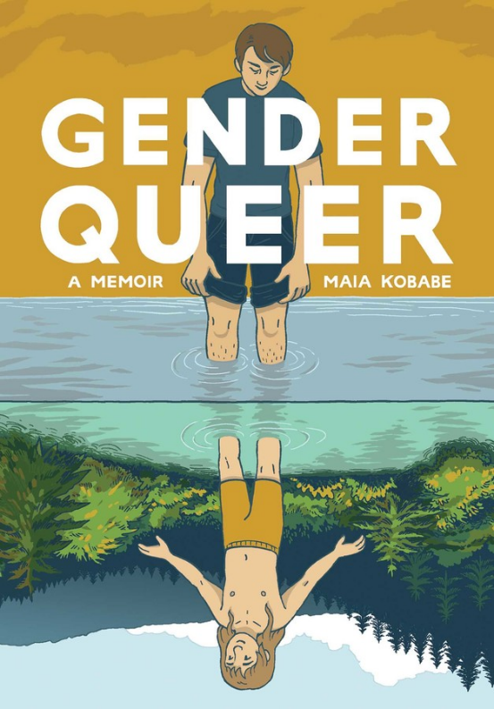
Gender Queer: A Memoir
Author Maia Kobabe uses gender-neutral pronouns e, em and eir
First published in 2019 by Oni Press
Award-winning: 2020 American Library Association Stonewall Honor and Alex Award
Opening discussion questions:
What is this memoir about?
Did anything surprise you while reading it?

Slide 3
Warning: The next slides contain images of nudity and Sex

Slide 4
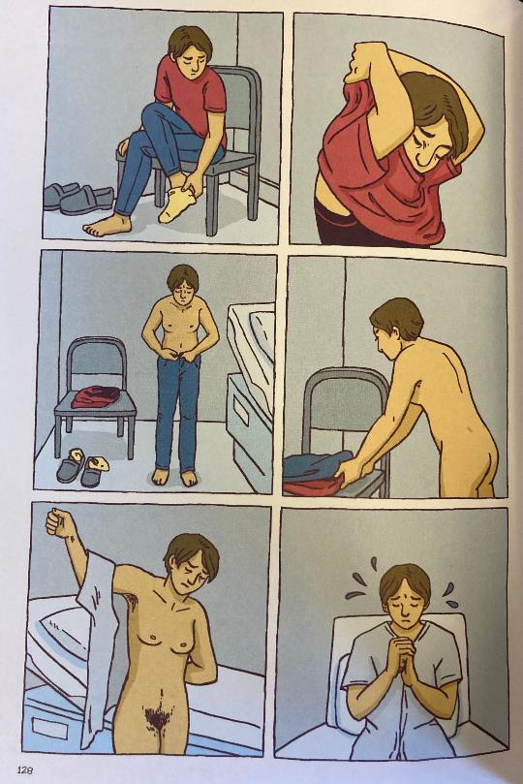
Nudity! Sex! Oh…my?
Image: a page from Gender Queer. In the panels, the main character Maia is shown undressing and putting on a white gown next to a bed in a medical examination room.
In the panels, there is no text to accompany the images. What are the visual cues that let readers know how the character is feeling?
What do we learn about the character Maia from this passage? How does it tie into eir overall story arc?

Slide 5
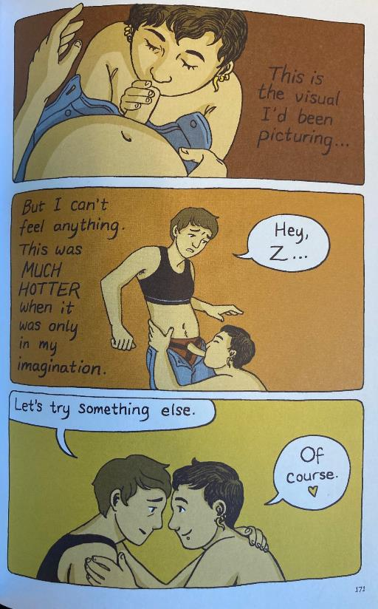
Nudity! Sex! Oh…my? (cont’d)
Image: a page from Gender Queer. In the panels, the main character Maia is shown looking down at Z who has a dildo in their mouth. Maia asks Z if they can try something else.
What visual similarities are there in this panel and the one on the previous slide? What are the differences?
These panels are the most controversial for being “sexually explicit.”
Kobabe argues that in order to talk about eir gender identity, e needed to also discuss eir relationship to sex and sexuality.
Discussion questions:
What is the reasoning behind this claim?
How would not having sex or sexuality in the book have impacted the story?
Do you think e could have told the story without the sexual images?

Slide 6
“One of the most banned books in the US”
Gender Queer was the number 1 most challenged book of 2021, according to the American Library Association Office for Intellectual Freedom, which tracks requests to remove books from libraries, schools, and universities.
According to the ALA, reasons for requesting removal include that it contains LGBTQIA+ content, and it is considered to have sexually explicit images that are inappropriate for high school age youth.
In late 2021, at a school board meeting in Fairfax County, Virginia, a parent raised concerns about the illustrations of LGBTQ sexual experiences. The parent equated the book with pornography, saying that it was “offensive to common decency.” At the meeting, the school board decided to pull the book from the schools’ libraries.
In the month after, the book was pulled from school districts in Florida, New Jersey, North Carolina.
In November 2021, South Carolina Governor Henry McMaster called on his state’s Department of Education to remove the book from all schools in the state – he reiterated the claim that the book was “obscene and pornographic.” He also demanded that similar books be removed from school shelves.

Slide 7
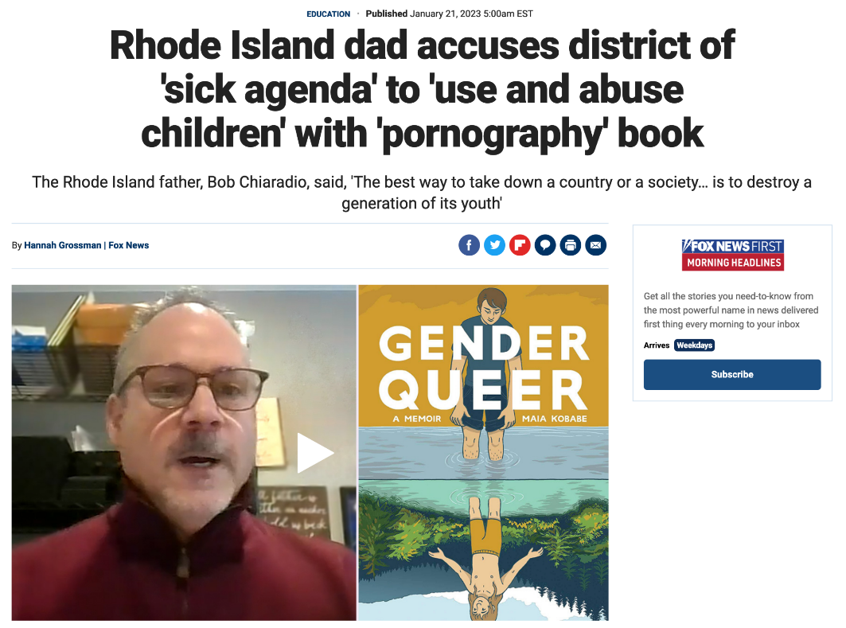
And the backlash is on-going…
Image: A screenshot of a news story dated January 21, 2023, shows a parent next to the cover of Gender Queer. The headline says, “Rhode Island dad accuses district of ‘sick agenda’ to ‘use and abuse children’ with ‘pornography’ book.”

Slide 8
Discussion Questions
Those who oppose pulling Gender Queer from library shelves argue that these challenges are not about books. What then are the challenges about?
Do you think the books’ portrayal of a non-binary/trans character contributed to descriptions of the book as “offensive”? How might heteronormativity and the association of queer and trans people as “perverse” and “immoral” influence this current backlash?
How might the graphic medium, rather than just the text itself, have contributed to the backlash? How might the historical association of comics with juvenile delinquency influence this current backlash?

Slide 9
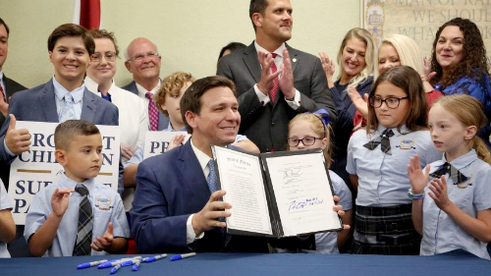
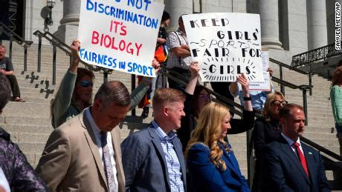
Cultural Context
The censorship of Gender Queer is just one example of increasing challenges to books with LGBTQ characters and explorations of LGBTQ identity.
According to the director of the ALA’s Office for Intellectual Freedom, books with LGBTQ characters–especially trans characters–make up the majority of books that have been challenged and pulled from schools and libraries.
According to the ALA, although these challenges go back to the 1990s, there has been an increase in attacks on LGBTQ+ content in schools over the past several years, coinciding with other political attacks on queer and trans youth.
Left: Florida Governor DeSantis, surrounded by elementary school children signs the so-called “Don’t Say Gay” Law.
Right: Utah legislators promote a bill that would ban trans youth from participating in school sports.

Slide 10
Discussion Questions
What is the impact of on youth who identify as LGBTQ+ when graphic narratives with LGBTQ+ characters and conversations are censored?
How does such censorship affect all youth, whether they identify as LGBTQ+ or not?
In the larger scheme of things, does it matter if Gender Queer is pulled from shelves? How? If not, why not?

Slide 11
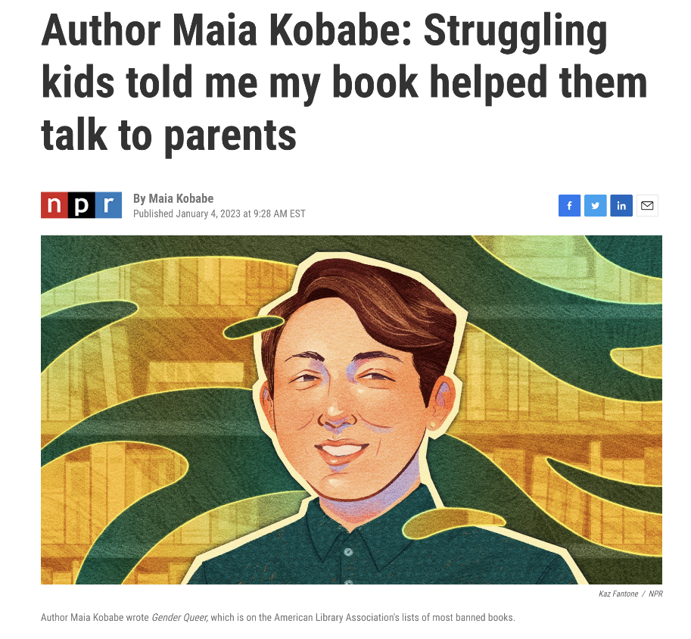
Maia Kobabe’s response:
“The first print run (just 5,000 copies) sold out the week the book was released. As I toured six states and numerous bookstores in 2019, I received only positive, often heartwarming and deeply moving, feedback. People told me they related to Gender Queer more than any other book they'd ever read. They told me it made them feel less alone. They told me they had shared the book with a parent, or a partner, or a friend, and it had opened up conversations they'd never been able to have before.”

