Slide 1
Queer Absences, Queer Presences
LGBT 550

Slide 2
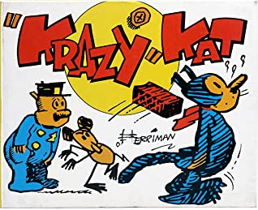
Krazy Kat,
1913-1944

Slide 3
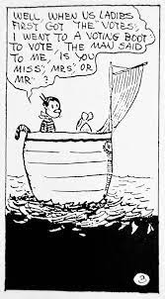
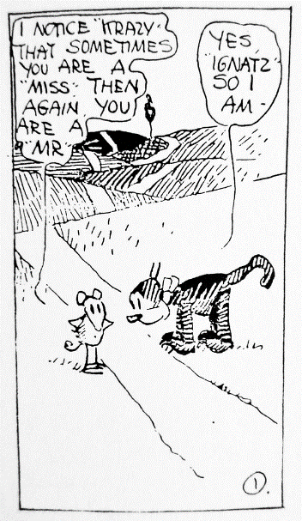
What’s Queer About Krazy Kat?
Krazy’s gender is ambiguous in the strip.
According to Ben Schwartz, at various points, the creator George Herriman said that Krazy has “no sex” and “can’t be a he or a she.”
Notes:
(Schwartz, Ben (2003). "Hearst, Herriman, and the Death of Nonsense." Printed in Krazy & Ignatz 1929–1930: "A Mice, A Brick, A Lovely Night.")

Slide 4
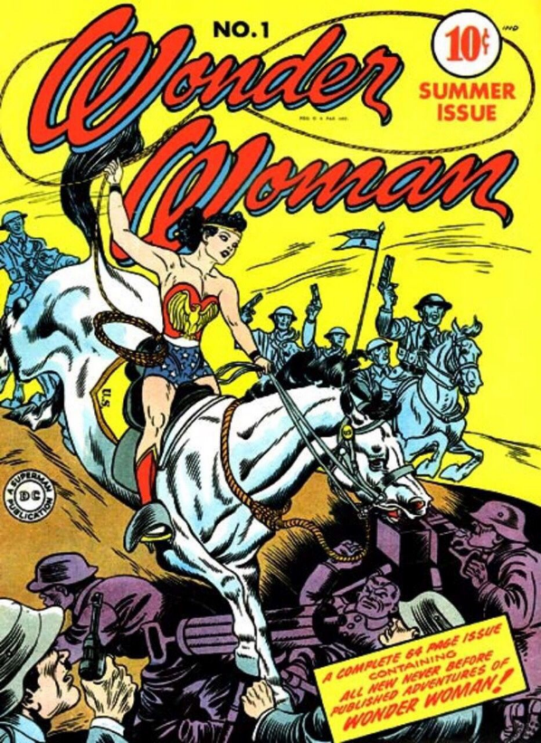
Wonder Woman,
1941-ongoing

Slide 5
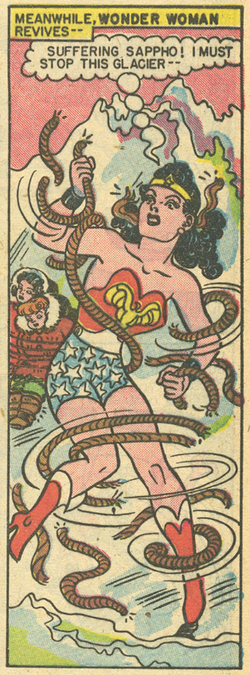
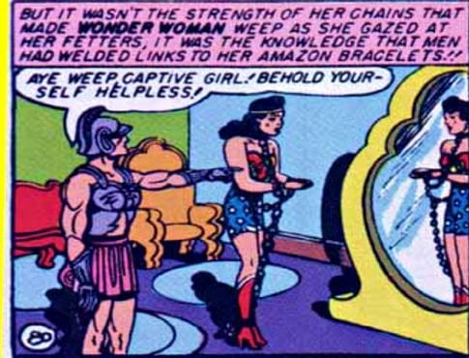
What’s Queer About Wonder Woman?
Creator William Moulton Marston was a self-identified feminist, who believed that women were superior.
He created Wonder Woman to give girls an example of a strong woman archetype that they could embody to become leaders that he believed should run society.
The all woman society of the Amazons was visually and textually linked to the island of Sappho.

Slide 6
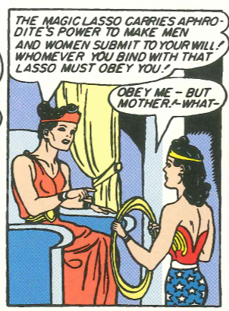
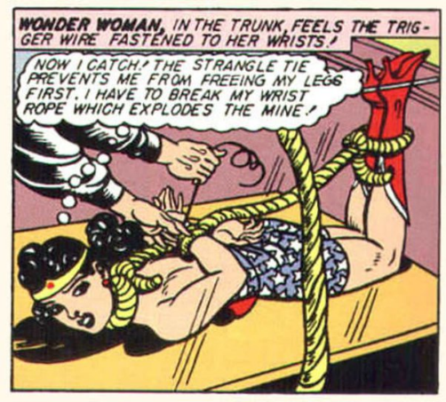
What’s Queer About Wonder Woman?
Marston practiced polyamory and bondage and submission; the imagery of the latter is central to the visual depiction of Wonder Woman.
In twenty-first century editions of the comic, same-sex desire by Wonder Woman is more concretely represented and acknowledged.

Slide 7
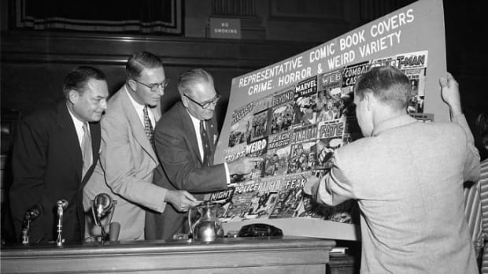

Slide 8
Suppressing Queerness in Comics
A twentieth century cultural discourse equated queer people with violence
Mogul, Ritchie, and Whitlock describe mass media representations of “gleeful gay killers, lethal lesbians, and deceptive gender benders”
At a televised United States Senate Subcommittee investigation in 1954, author Fredric Wertham testified that the homoeroticism and gender non-conformity of comic book characters from Batman and Robin to Wonder Woman were linked to juvenile delinquency and violence
As a response, the comic book industry created its own self-censorship program called the Comics Code Authority (CCA) in 1954.

Slide 9
The Comics Code Authority
From 1954-1989, the code “prohibited American comic book publishers from depicting ‘nudity in any form,’ ‘illicit sex relations,’ and a loosely defined and potentially vast array of ‘sexual abnormalities and perversions’; for most of the Code’s history, same-sex desire was one such perversion” (Peppard, p 2).
Anna Peppard argues that the code was designed to suppress queerness in comics, and indeed, explicitly sexual comics were driven underground and out of mainstream outlets.
The suppression of horror, crime, and “weird” comics made superhero comics the dominant genre.
Notes:
“Presence and Absence in Theory and Practice” by Anna F. Peppard (in Supersex, 2020, University of Texas Press)

Slide 10
“Presence and Absence”
Given the queer subtext of superhero comics, Peppard argues that sexual and gender deviance continued to be both “obvious and elusive, conservative and subversive” (p 3).
As we read mainstream comics, look for both absences of queer content, and also look presences that can be interpreted as “queer.”
Queer themes in mainstream comics
Gender ambiguity/androgyny
Gender non-normativity – masculine women, feminine men
Homosocial spaces and relationships
Tools/weapons/outfits/spaces suggestive of BDSM – leather, dungeous, whips
Sexually suggestive outfits – tight cuts, underwear on the outside
Encounters that are suggestive of sex – gooey projectiles, entwined bodies
Others?

Slide 11
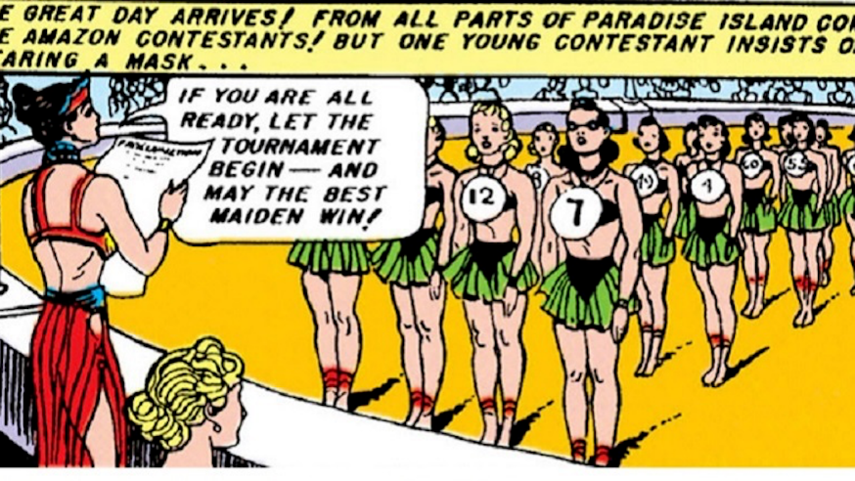
Practice 1
Describe what is occurring in the frame – what is present?
Can you tell what comic this is?
What is absent from the frame?
What messages do the presences and absences in this strip send about normal, natural, and acceptable bodies?

Slide 12
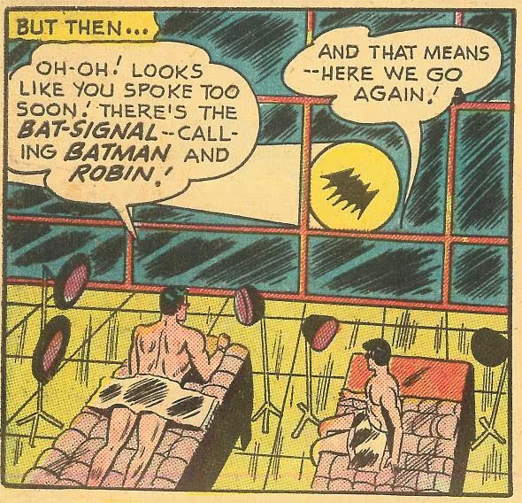
Practice 2
Describe what is occurring in the image – what is the “text”?
What are the visual and textual cues that something queer is happening or could be happening? What is the “subtext”?
Are there any stereotypes about queerness are being depicted here?
What is the message about queerness that emerges from this single representation?
Notes:
“World’s Finest No. 59 from 1952, in which naked Bruce and Dick lie next to one another, languidly bronzing their brawny physiques under matching sun lamps.”

Slide 13
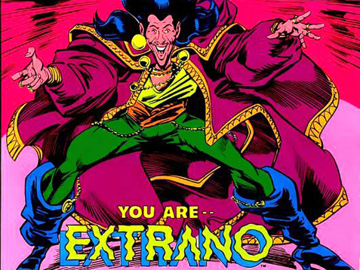
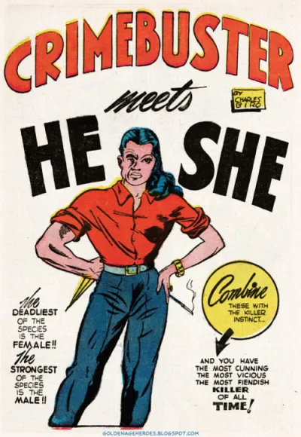
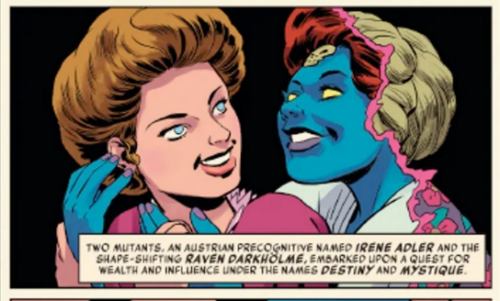
No image occurs in a vacuum…
What happens when representations are repeated?
Notes:
Boy Comics #9, 1943
DC character Extraño, first appeared in Millennium #2 (January 1988)
The Uncanny X-Men’s Mystique and Destiny

