Slide 1
What’s Queer About Comics?
LGBT 550 - Week 2

Slide 2
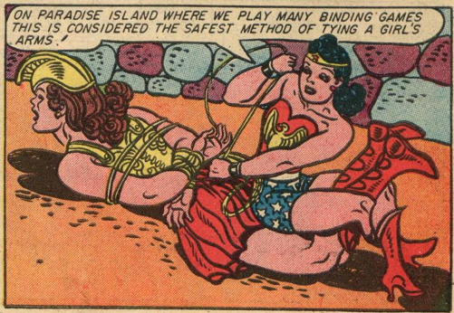
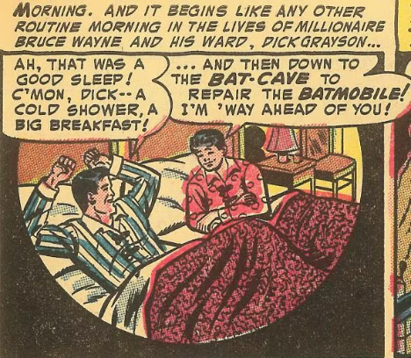
Queer Subtext in Early Comics
Visual and literary cues in early comics including Wonder Woman and Batman were interpreted during the Cold War “Lavender Scare” as dangerous depictions of homosexuality and gender non-conformity.
This queer subtext contributed to the creation of the Comics Code Authority, which censored depictions of sex and sexuality in mainstream comics for decades.
Notes:
A frame from an early edition of Wonder Woman
A frame from an early edition of The Batman

Slide 3
“There’s Something Queer About Comics”
Darieck Scott and Ramzi Fawaz point to long-term themes within comics that challenge heteronormativity.
This includes representations of alternative “chosen family“ formations, homosocial communities, kink and BDSM (think Wonder Woman), critiques of domesticity, and the “sublimation of desire” within the gender roles of the nuclear family.
Using the methodologies of queer studies which pay attention to subtexts of gender, sex, and sexuality, we can queerly “read” comics, using “Comics themselves [to] ‘queer’ the archive of US culture.”
Notes:
Scott, Darieck and Ramzi Fawaz. 2018. “Introduction: Queer about Comics.” American Literature, 90: 2, June 2018.

Slide 4
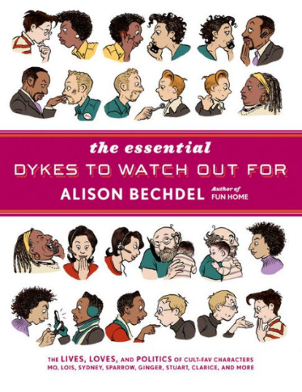
Underground and Indie Comics
Additionally, underground comix and independent comics (those not subjected to the Code) have been an important part of queer culture for decades.
Gay and lesbian publications (and the gay and lesbian bookstores that carried them) provided a space for groundbreaking queer comics, which became an important part of LGBTQ+ culture.
Images: the covers of The Complete Kake Comics by Tom of Finland and The Essential Dykes to Watch Out For by Alison Bechdel
Notes:
Left to Right:
The Complete Kake Comics by Tom of Finland
The Essential Dykes to Watch Out for by Alison Bechdel

Slide 5
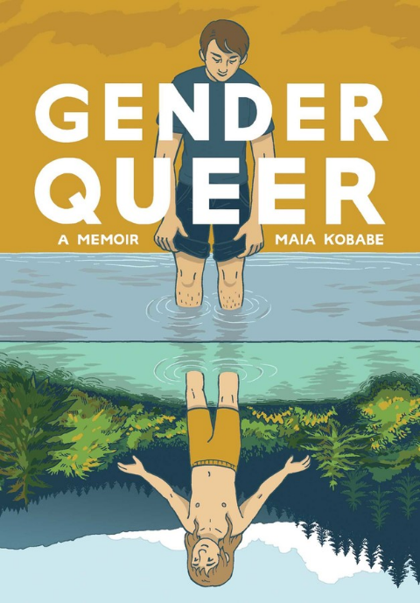
Queer Comics After the Code
There has been a 21st century explosion in using the graphic medium to tell queer and trans stories. These texts have become flashpoints in the cultural struggle to suppress different sexual and gender identities in the US
For example, Gender Queer: A Memoir by Maia Kobabe has been censored and banned from multiple school districts in the US, due to claims that it contains sexually explicit content. The debate over the book mirrors a larger cultural conversation about queer and trans identities.
Notes:
Gender Queer: A Memoir by Maia Kobabe

Slide 6
Queer and Trans Studies Through Comics
Comics are a way to examine the history of queer culture and community, including experiences with suppression in the mid-twentieth century;
Comics are a way to study the shifts in changing understandings of sex, gender, sexuality, and identity; and
Comics are a way to learn about how LGBTQ+ communities and social movements have formed in resistance to oppression.

Slide 7
The Politics of Queer Representation
Comics are one way to examine the politics of representation of LGBTQ+ lives and experiences and how representation has changed over time
In this class we will examine:
The consequences of the absence of complex queer and trans representation
The inescapable queer and trans presence that becomes obvious through queer readings,
The stereotypes that are reproduced when queer and trans people have appeared, and,
How queer and trans people have subverted and exceeded these narrow representations.

Slide 8
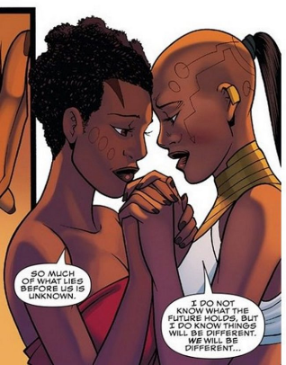
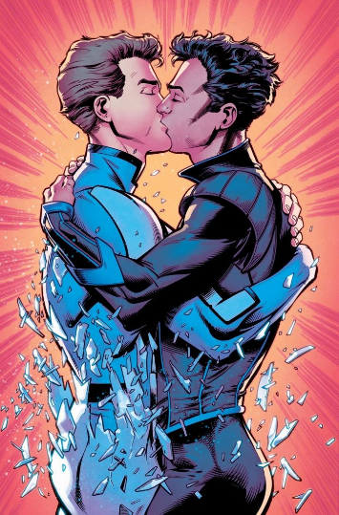
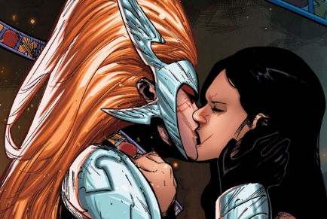
Mainstream Comics Go Queer
What are the politics of these mainstream representations?
How has mainstream representation changed over time, or not changed?
Who is creating these characters and do they represent actual queer and trans lives?
Left bottom to Right:
Angela: Asgard’s Assassin’s Angela and Sera
World of Wakanda’s Ayo and Okoye
Bobby/Iceman gets his first kiss in The All New X-Men
Notes:
Left bottom to Right:
Angela: Asgard’s Assassin’s Angela and Sera
World of Wakanda’s Ayo and Okoye
Bobby/Iceman gets his first kiss in the All New X-Men

Slide 9
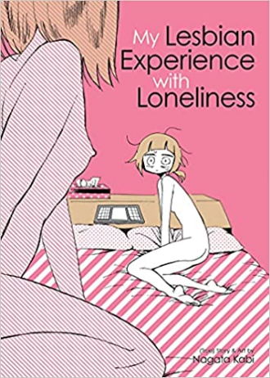
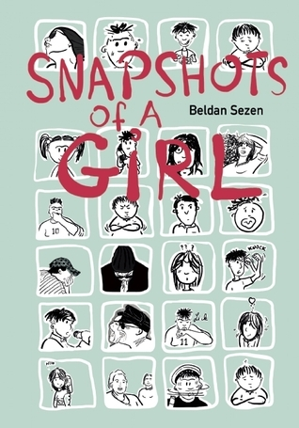
Race, Gender, and Sexuality
We must also discuss the intersection of race, gender and sexuality in comics.
Which comics are chosen to represent LGBTQ+ comics? Which LGBTQ+ comics are the most studied by comics studies scholars?
This class will also introduce you to less well known comics created by LGBTQ+ creators of color.
Left to right:
Sexile by Jaime Cortez
Snapshots of a Girl by Beldan Sezen
My Lesbian Experience with Loneliness by Nagata Kabi
Notes:
Left to right:
Sexile by Jaime Cortez
Snapshots of a Girl by Beldan Sezen
My Lesbian Experience with Loneliness by Nagata Kabi

Slide 10
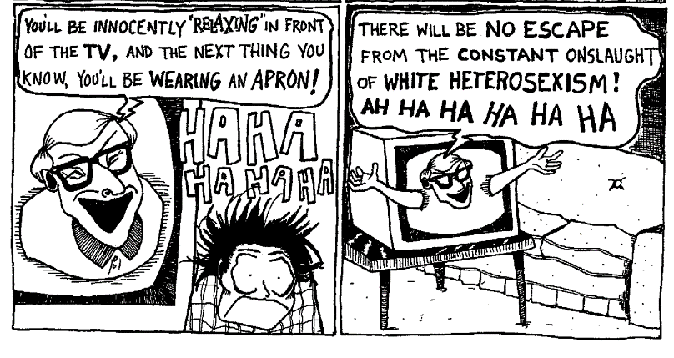
Comics As a Queer Form
Scott and Fawaz provoke us to read Comics as “a distinctly queer mode of cultural production” (199).
In addition to the content, they argue that the form of comics is queer communication, one that disrupts linear narratives and visually evokes sensations of the body that the written word alone can’t achieve.
Image: Two panels from the underground comic Hothead Paisan: Homicidal Lesbian Maniac. What sensations and emotions do the visual elements evoke?
Notes:
Hothead Paisan: Homicidal Lesbian Maniac

