Slide 1
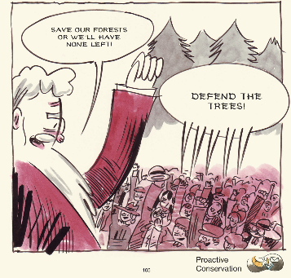
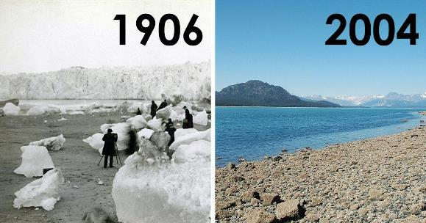
Introduction to Environmental Humanities
Dr. Soljour
Department of Classics & Humanities

Slide 2
Overview
Lecture
What is Environmental Humanities?
Approaches to Environmental Humanities
Environmental Humanities Scholarship
Environmental Issues Impacting our Nation

Slide 3
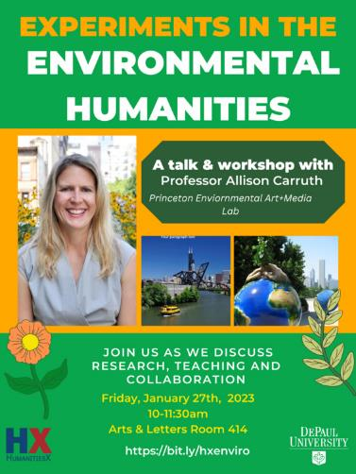
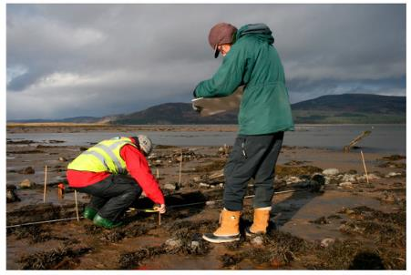
What is Environmental Humanities?
Environmental Humanities is an academic discipline that reflects the growing conviction that environmental issues cannot be solved by science and technology alone.
Environmental Humanities emphasizes the important role that history, philosophy, literature, the arts, and interpretive social sciences plays in:
Producing solutions to environmental problems.
Understanding how those problems arose.
Improving environmental outcomes.
The field makes interdisciplinary connections between environmental philosophy, environmental history, ecocriticism, cultural geography, cultural anthropology, and political ecology.
Scholars and practitioners actively make recommendations that shape public debate and policies on environmental issues.

Slide 4
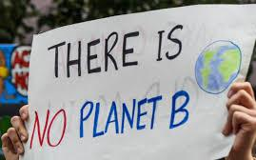
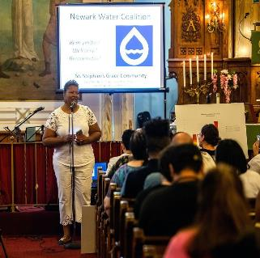
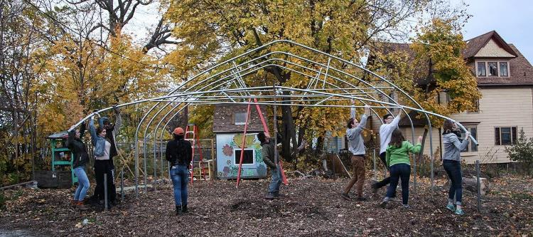
Approaches to
Environmental Humanities
Environmental Humanities encompasses a number of research and public-facing approaches:
In terms of research, both scholars and practitioners use transdisciplinary approaches to examine the relationship between human life, culture and the planet.
These approaches reexamine the history of humanity in terms of climate change, use of energy, natural resources and ongoing mass extinction.
In terms of public engagement, researchers pose questions like: “what is the environment?”, “how did we get into this crisis?”, or “who survives, who gets to live well, how do we live together?”
Using these questions, scholars and practitioners engage the public in participatory modes of research using case studies or civic engagement activities, debate, creative expression (ex. documentaries) and policymaking processes.

Slide 5
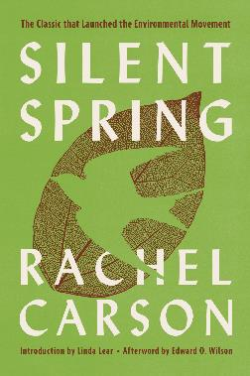
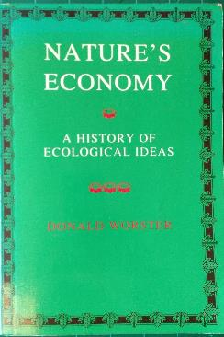
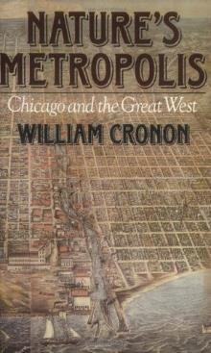
Environmental Humanities Scholarship
Environmental Humanities as a formal field of academic study is a 21st century development!
For the past 40 years, scholars in humanities and social science fields such as literature, history, philosophy, gender studies, and anthropology contributed “environmentalism.”
Environmental Humanities encourages scholars and practitioners to work collaboratively.
Scholarship began emerging in the 1960s.
This lecture will examine 3 canonical texts from the 60s, 70s, and 90s.
These texts helped shape the field and educate American citizens.
Rachel Carson, Silent Spring
Donald Worster, Nature’s Economy
William Cronon, Nature’s Metropolis (Chicago & The Great West)

Slide 6
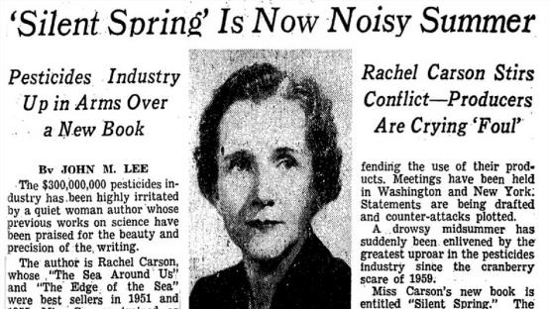
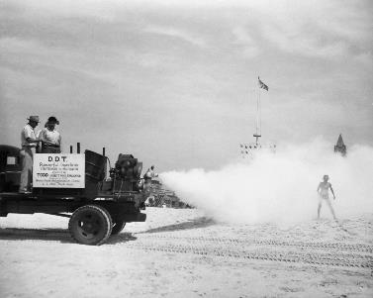
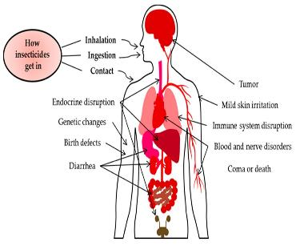
Rachel Carson, Silent Spring (1962)
Rachel Carson was an marine biologist, writer, and conservationist best known for her work highlighting the dangers of the insecticide DDT.
In the book Silent Spring published in 1962, Carson argues that synthetic pesticides were destroying vegetation and harming animals.
These synthetic pesticides were developed through military funding after World War II.
In 1957, landowners in Long Island filed a suit to stop the spraying of DDT, but lost the case.
These research findings were shared with Carson, who used this evidence.
In the book, she coins the word "biocides" to describe DDT because the effects of pesticides are not limited to solely targeting pests.
The book was strongly opposed by chemical companies, including lawsuits filed that her research was libel (a published false statement that is damaging to the company’s reputation) and propaganda.
The impact of Silent Spring inspired a grassroots environmental movement, which resulted in the following outcomes.
A nationwide ban on DDT and other pesticides.
The creation of the U.S. Environmental Protection Agency.

Slide 7
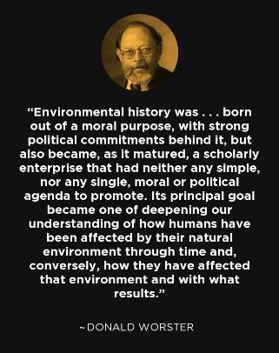
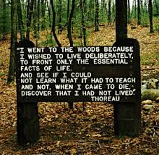
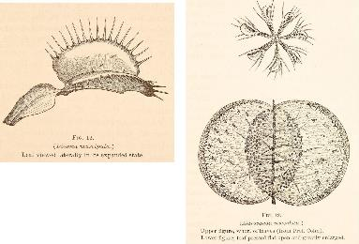
Donald Worster, Nature’s Economy (1977)
Dr. Donald Worster is an environmental historian, who is credited as one of the founders of environmental history.
Published in 1977, Nature’s Economy, examines the role of nature in the history of ecology.
Ecology is the study of organisms and how they interact with the environment around them. Ecologists study the relationship between living things and their habitats.
He traces the origins of the ecology to the 18th century, discusses the thinkers who shaped the field, and how their work shaped modern perceptions of our place in nature.
Worster redefines farms and gardens as "domesticated ecologies," meaning humans changed these surroundings and were changed by these environments.
Donald Worster focuses on 5 shifts in ecological history including:
Ecology in the Eighteenth Century: The Empire of Reason
Thoreau's Romantic Ecology: Nature in the Wilderness
Darwinian Ecology
The Morals of a Science: Ethics, Economics, and Ecology
The Age of Ecology: Science and the Fate of the Earth

Slide 8
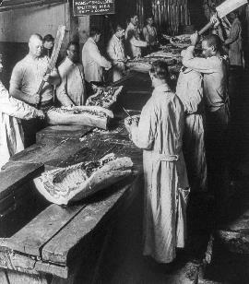
William Cronon, Nature’s Metropolis: Chicago and the Great West (1991)
Dr. William Cronon is an environmental historian, best known for challenging mainstream environmentalist definitions of nature.
He argued that the focus on wilderness preservation leads us to neglect of the everyday places in which we live.
Cronon uses Chicago as a case study to explore the relationship between city and country.
Particularly how Chicago linked goods (from nature) to people (controlling nature).
Central to Chicago's rise was the expansion of the railroads.
Railroads altered people's relationship with space, rerouting river and road transportation.
Using three industries (grain, lumber, and meat) to understand how Chicago interacted with the surrounding region.
His central argument is that through the process of commodification, natural products lost their ecological identities and were turned into capital.
In the case of grain, the rise of the grain elevator meant farmer's grain could be mixed together in a standard way.
In the case of meat, a vast meatpacking industry (enabled by the rise of refrigerated railroad cars) took animals and disassembled them into discrete parts, utilizing more and more of the animal parts and further distancing consumers from the reality of the animal itself.
His largest argument is that consumerism fueled economic and cultural colonization of the West.

Slide 9
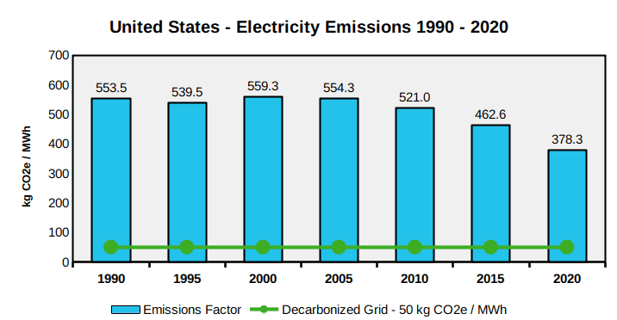
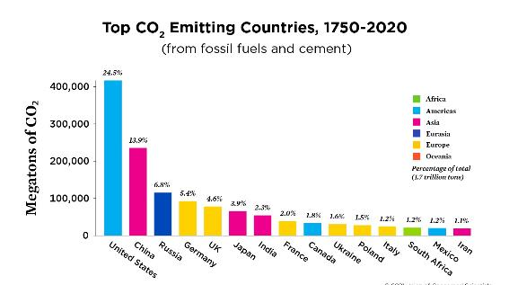
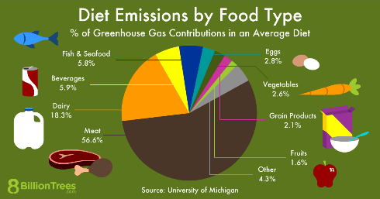
Environmental Issues impacting our Nation
The United States is among the most significant emitters of greenhouse gasses in the world.
In terms of both total and per capita emissions, it is among the largest contributors.
Environmental issues in the United States include: climate change, energy, species conservation, invasive species, deforestation, mining, nuclear accidents, pesticides, pollution, waste and over-population.
Despite official measures, the rate of environmental issues is increasing rapidly instead of reducing.

Slide 10
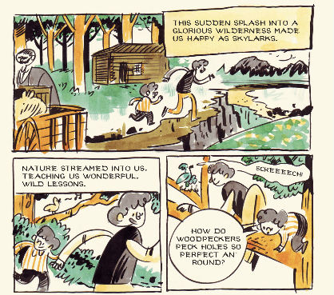
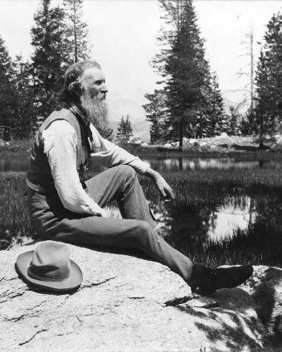
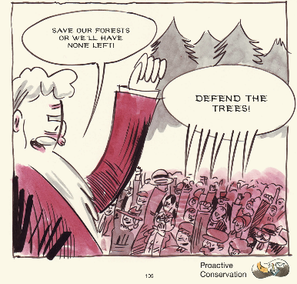
Comics Reading for this Week!
John Muir, Earth-Planet, Universe
Questions to Consider:
How did Muir’s early life impact his activism?
Why did Muir chose to immigrate to the United States?
What was Muir’s vision for protecting the environment?
John Muir (1838-1914)
Known as the “Father of the National Parks.”

