Slide 1
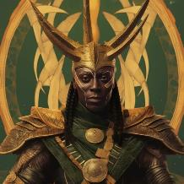
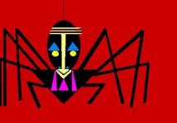
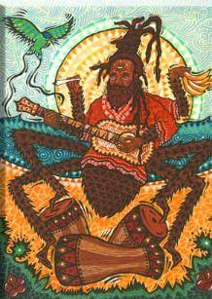
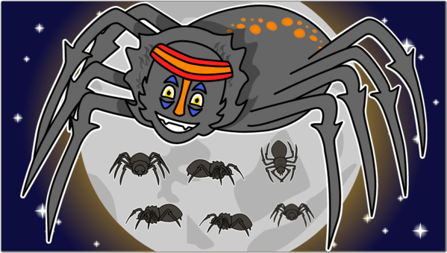
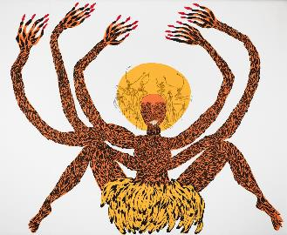
African Folklore:
Anansi & Spider Man
Dr. Soljour
Department of Classics & Humanities
Notes:
]
“Brother Anansi, the Spider, that great cultural hero of West Africa who is personated in Haiti by Ti Malice and in the United States by Brer Rabbit.”
― Zora Neale Hurston, Tell My Horse: Voodoo and Life in Haiti and Jamaica

Slide 2
Overview
Introductions
Lecture
Oral and written transmission of stories in African Culture
History of Anansi the Spider
The Transatlantic Slave Trade
The Legacy of Anansi in the “New World”

Slide 3
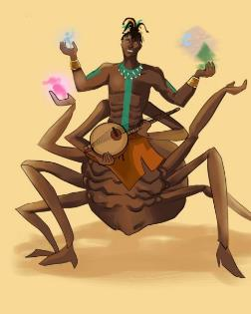
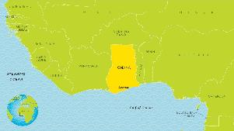
Who is Anansi the Spider?
Originating in Ghana, Anansi is the Akan word for “spider.”
He is one of the most important characters in West African, African American and West Indian folklore.
Anansi is depicted in many ways with different names.
Such as: Kwaku Ananse, Anancy, Kompa Nanzi, Nancy, Aunt Nancy and Sis' Nancy.
Anansi is best known for his ability to outsmart and triumph over more powerful opponents.
Notes:
]

Slide 4
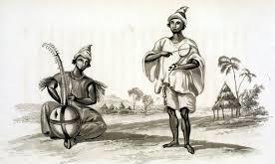
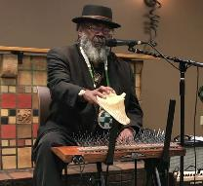
How the Word Was Passed….
Oral tradition or storytelling: often accompanied by ceremony and performance.
Community transmission: these stories, songs, and ceremonies were often retold and performed over generations.
Written transmission: the process of oral stories becoming written literature was facilitated by scholars and practitioners inside and outside of the communities of origin.
Griot: is a West African historian, storyteller, praise singer, poet, and/or musician that relies on the oral tradition. (Sierra Leone, 17th century)
Modern Day Griot: Dr. Arthur Flowers

Slide 5
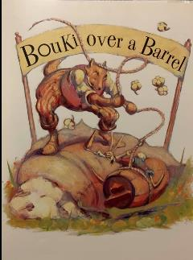
Anansi: The Trickster
Trickster Characteristics!
The trickster is usually the protagonist.
They usually cause problems for the other characters in the story.
They usually go unpunished
They usually take on animal form
Leuk, Rabbit (Senegal)
Bouki, Hyena (Senegal/Louisiana)
Anansi, Spider (Ghana/Caribbean)

Slide 6
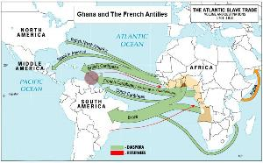
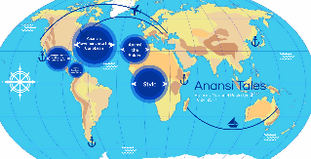
Anansi & the African Diaspora
Between the 15th -19th century, an estimated 12-15 million African people were enslaved and forcefully displaced.
Displaced Africans were relocated to North and South America, Europe and the Caribbean.
As a result of the transatlantic slave trade, we have the creation of an African Diaspora.
Diaspora: the forced movement, forced migration and the scattering of a group of people from their ancestral homeland.

Slide 7
Anansi & the African Diaspora: Jamaica
Anansi is best known for his ability to outsmart and triumph over more powerful opponents.
He became a symbol of slave resistance/survival and provided a sense of continuity with an African past.
**Pay close attention to how the story explains the role of Anansi **
Notes:
]

Slide 8
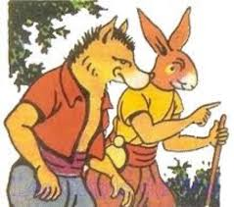
Anansi & the African Diaspora: Haiti’s Ti-Malice and Bouki
Ti Malice is a trickster figure in Haitian folklore.
He is cunning and clever, but lazy.
(Ton-Ton) Bouki is greedy and dim-witted, but hardworking.
The stories of Ti Malice and Uncle Bouki were primarily passed down in oral tales and some originate from Anansi.
His characteristics were divided between the two animals (the rabbit and the hyena).
Ti Malice (The Rabbit)
Bouki (The Hyena)
Sos Ti Malice

Slide 9
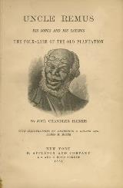
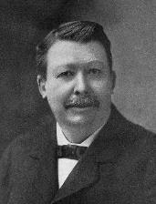
Anansi & the African Diaspora: Br'er Rabbit in the American South
Br'er Rabbit (an abbreviation of Brother Rabbit) is a central trickster figure in oral traditions passed down by African-Americans in the American South.
Adaptations of Br’er Rabbit reached new and “popular” audiences through the authorship of Joel Harris.
Harris created the character “Uncle Remis”
Remis is used as a griot-like figure that shares versions of Anansi tales often with unfruitful endings.
The most famous of the Anansi stories adapted by Remus is Tar Baby.
Joel Harris was an American journalist amd fiction writer, best known for creating the character Uncle Remus.

Slide 10
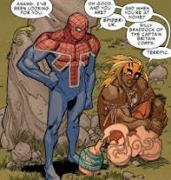
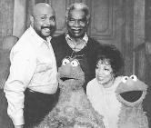
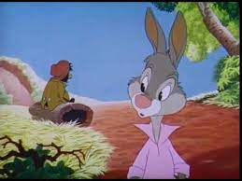
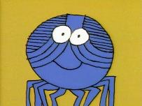
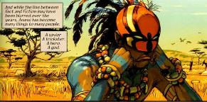
Anansi in Contemporary Media
Disney’s Depiction of Br’er Rabbit & Tar Baby in Song of the South (1946).
Ossie Davis (1917-2005) voiced a recurring Sesame Street animated segment as the voice of Anansi the Spider in 1996.
Kwaku Anansi (Earth-616) is a character within Marvel’s multiverse identified as the first Spiderman character in 2002-2003.
Notes:
https://allthatsinteresting.com/kwaku-anansi

