Slide 1
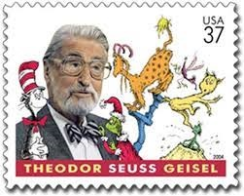
Comics for K-12 Educators
Week 6

Slide 2
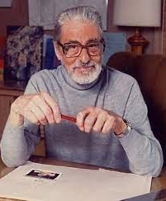
To Discuss
What do you know about Dr. Seuss?
What are your feelings about Dr. Seuss?
Why do you think Dr. Seuss’s books have recently been challenged/banned in some places?

Slide 3
Dr. Seuss’s Political Cartoons
Take some time to look over and analyze Dr. Seuss’s political cartoons: Open Culture Website
What are your responses to these images?
Would you use them in a K-12 classroom? Why or why not?
Notes:
Give students 15-20 minutes to review images, skim website discussion, and add their responses to a Jam Board. Discuss as a whole group. Do these cartoons alter their views of Dr. Seuss in any way? How do they feel about “cancel culture”? Should Dr. Seuss be cancelled?

Slide 4
Propaganda
Information, especially of a biased or misleading nature, used to promote or publicize a particular political cause or point of view (Google Dictionary)
Where do we see propaganda in society today?
What count as “propaganda” and what does not?
Notes:
Review definition, discuss historical examples of propaganda – connected to Dr. Seuss’s political cartoons – and brainstorm ideas for where propaganda is seen today.

Slide 5
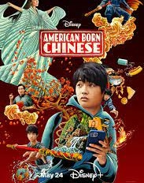
American Born Chinese
How does Gene Luen Yang’s American Born Chinese speak back to anti-Asian and anti-Chinese propaganda?
Notes:
Show students a brief clip of American Born Chinese and ask them to discuss how this film speaks back to (and also plays with) anti-Asian and anti-Chinese propaganda. They are reading the book this week and should consider the differences between the graphic novel and this clip.

Slide 6
Discussion #6
TO DO:
Discussion #6 ~ Name TWO ways in which Yang’s American Born Chinese challenges the history of propaganda in comic texts, as evidenced in the work of Dr. Seuss and as discussed in Scott’s (2007) article. What activities might you do with K-12 students to address/redress racist and/or nationalistic propaganda, using a text like Yang’s?

