Slide 1
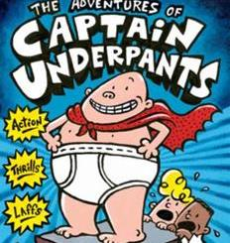
Comics for K-12 Educators
Week 3

Slide 2
To Discuss
With which representations of comic characters of color are you most familiar?
How many comic book (or graphic novel) characters of color can you name?
Notes:
Have students discuss collectively or in breakout groups (depending on class size) and then share to the whole group.

Slide 3
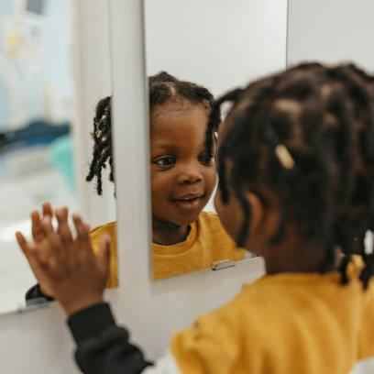
“Mirrors, Windows, and Sliding Glass Doors”
Read Rudine Sims Bishop’s “Mirrors, Windows, and Sliding Glass Doors” (1990).
Be prepared to discuss:
What texts (comic or otherwise) have served as “mirrors” to you and why?
What texts (comic or otherwise) have served as “windows” to you and why?
Is this article still relevant today? Why or why not?
Notes:
Give students 15-20 minutes to read the Bishop text and write notes in response to these questions. Then, facilitate a discussion related to these questions. It will be important to interrogate how the “mirror” is conceptualized. Is the VISUAL enough? What else might need to be present in a comic text (or any other text) for it to feel relevant to you?

Slide 4
What is Critical Race Theory (Dando, 2023)?
TENETS:
LEGAL analytical framework – struggle against racism
(Literacy) curriculum is laden with white supremacist messaging (the “hidden curriculum” (Giroux, Apple)
Counterstorytelling is a powerful way for POC to fight racism (e.g., via comics)
Notes:
See Dando, 2023 for references for these points; students should read the entire article on their own in order to cite it adequately in the discussion post this week.

Slide 5
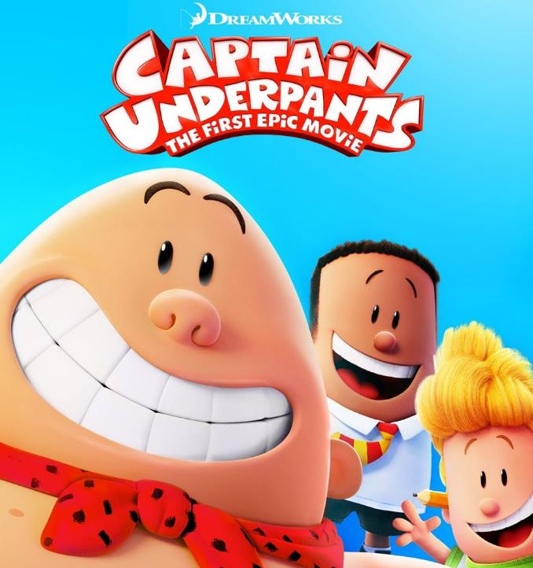
Captain Underpants
View movie trailer: CAPTAIN UNDERPANTS MOVIE
Who do the characters in The Adventures in Captain Underpants mirror? Why?
Notes:
Get students to consider the degree to which the two boy characters are distinguishable from one another, aside from their visual racial differences. How is “representation” of the Black character in this text different from the representation of the Black heroes in other comics? Students should take a moment to look up other comic book character of color with which they are familiar (named in the first discussion), and share them with the group.

Slide 6
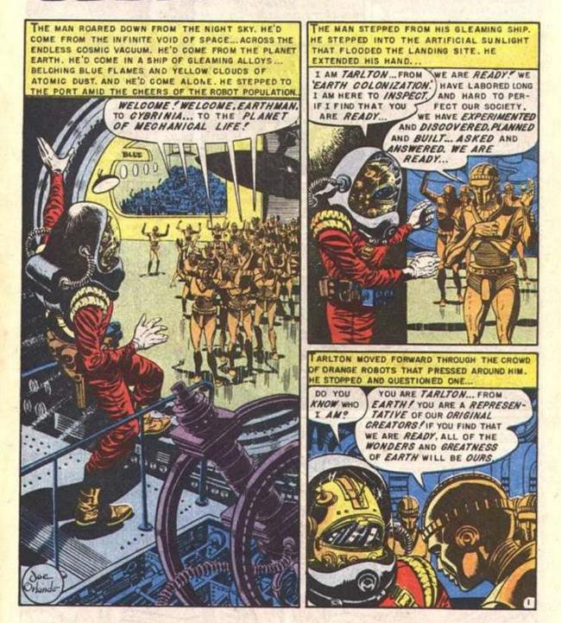
Judgment Day
Read Al Feldstein’s Judgment Day (1953): CBLDF Website
Discuss in Small Groups:
How is Black representation in this comic different from the Black representation in Captain Underpants?
Why do you think Judgment Day was controversial at the time it was published?
Notes:
Give students 20-30 minutes to read this comic in its entirety online and discuss the questions in small groups. They should document their answers in a Google doc, collaboratively, for in-class work credit. Then they should share to the whole group.

Slide 7
Discussion #3
TO DO:
Discussion #3 ~ Look back on the comic texts you selected in Week 1 and Pilkey’s The Adventures of Captain Underpants. Which groups of students do you think each of these texts might “mirror” (Bishop, 1990)? How might the comic texts you select for students, going forward, (continue to) reflect the social justice efforts of publishers like EC Comics, as noted by Whitted and reflected in Judgement Day? How might you apply a Critical Race Theory framework to your teaching of comics?

