Slide 1
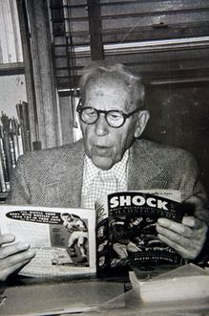
Comics for K-12 Educators
Week 1

Slide 2
For Discussion
What are some descriptions of comics that come to mind, when you think about how teachers might describe them in the K-12 literacy classroom? Where do you think these ideas come from?
Feel free to draw from personal experience as a student, an educator, a parent, etc.
Notes:
Capture notes from discussion in a Google JamBoard, asking student to add sticky notes with the words they come up with. Then ask them to share where they think these ideas came from.

Slide 3
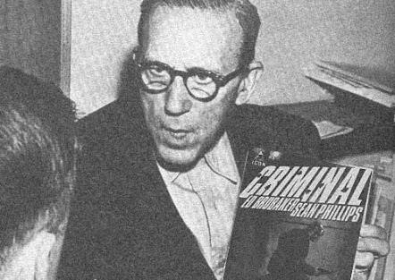
Introducing Fredric Wertham
Child psychologist
Published Seduction of the Innocent in 1954
Known as “the bogeyman of comics”
Claimed comic books were violent and a direct cause of juvenile delinquency
TO WATCH: WERTHAM VIDEO
Notes:
Briefly introduce Fredric Wertham. How many of them have heard of him? What do they know? Has anyone every heard the idea that comic books cause delinquency or harm to children? When/where?
After discussion, show Wertham video to students.

Slide 4
The Comic Book Legal Defense Fund (CBLDF)
CBLDF Website
Scavenger Hunt:
What does the CBLDF do?
Name one tip for educators found on the CBLDF website.
Name one book the CBLDF has defended/supported.
What is The Comics Code (describe in brief)?
How is MAD MAGAZINE connected to censorship?
Notes:
Create Google form or other document for students to submit their responses. Collect and check as an in-class assignment.

Slide 5
Share Out
What is your own personal background with comics and/or graphic novels?
How do you feel about comics and/or graphic novels? Why?
How often have you read comics and/or graphic novels? Why?
Notes:
Students will share out their personal experiences with comics, as a precursor to the discussion assignment for this week – to be posted on Canvas:

Slide 6
Discussion Post #1
TO DO:
Discussion #1 ~ Which two comic texts did you select on your own and read this week, and why do you deem them “appropriate” or “inappropriate” for young readers? What do you think Wertham would say about these texts? What do you think the CBLDF would say? What do you think your own background with comics has to do with your assessment of the two texts you selected for this week?
Notes:
Discuss recommendations for selecting comic texts for this week’s reading and prompt. Instruct students to be clear on what they mean by “inappropriate” and “appropriate” and why. Remind them to answer all parts of the prompt.

