Slide 1
Sacred Stories in Comic Form
Bible (Comics Bible, Action Bible and Word for Word),
Bhagavad Gita (ACK), and Buddha (ACK & Manga)

Slide 2
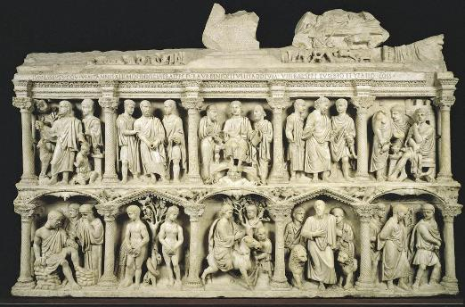
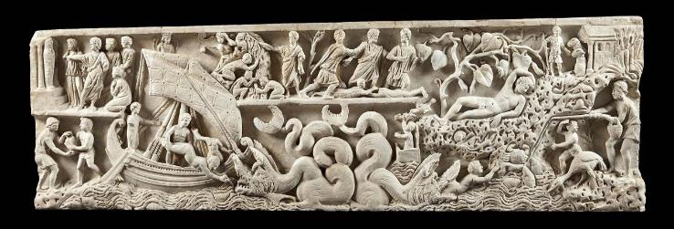
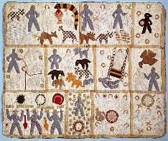
Sacred Stories and Sequential Art - Christianity
Sarcophagus of Jonah (ca. 300 CE)
Sarcophagus of Junius Bassus (lived 317-359) from the Treasury of Saint Peter’s Basilica
Sarcophagi and Jesus Story
Harriet Powers’s Bible Quilt (1885-6)
Smithsonian - https://www.si.edu/object/1885-1886-harriet-powerss-bible-quilt%3Anmah_556462
Sarcophagus with scenes from the Passion of Christ from the Catacombs of Domitilla (ca. 350 CE)

Slide 3
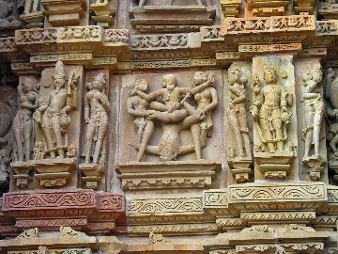
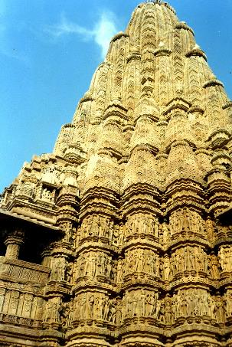
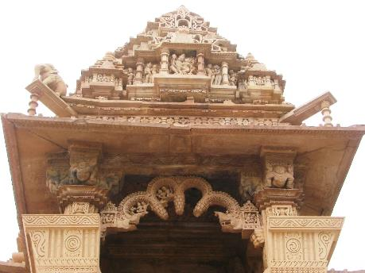
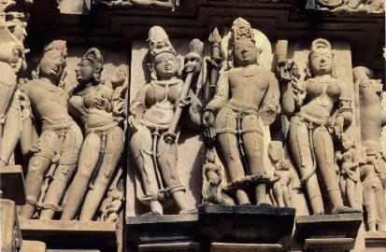
Hindu Art
Sculpture and Mythic Stories as Part of Temple Architecture
Great Relief Mammalapuram (ca. 630-728 CE)
Kandariya Mahadeva Temple - Erotic (Maithuna) and other images on exterior (ca. 1004-1035 CE)

Slide 4
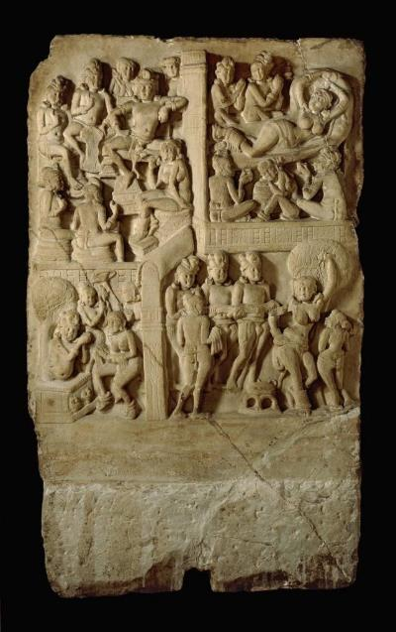
Buddhist Stories
“Narrative Art” (question of whether starts as a single scene epitome or cycle of pictures/stories)
(JSTOR article and Buddhist/China https://www.jstor.org/stable/20111252
Gandhara narrative art (1st-3rd C CE)
Panel from the Great Shrine of Amaravati - final Jataka (1st C CE) from British Museum
https://www.britishmuseum.org/blog/history-storytelling-through-pictures

Slide 5
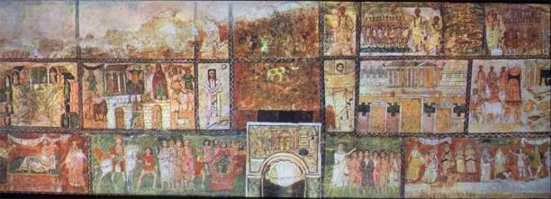
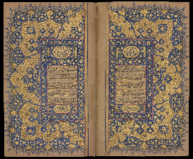
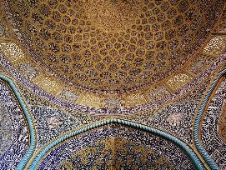
Sacred Images and Idolatry - Judaism and Islam
Judaism - the 10 Commandments (early exceptions - Dura Europas)
Islam - no images of prophets - potential for idolatry (Persian imagery) - focus on the text itself as art

Slide 6
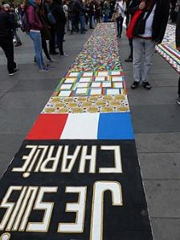
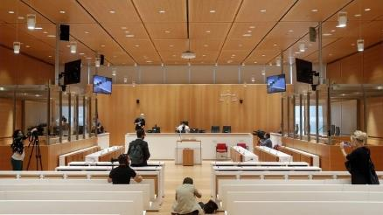
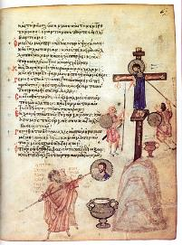
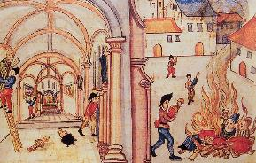
How to Treat Religious Imagery and Comics
Charlie Hebdo Mohammed Cartoon - Case Study and Issues
Question of how we treat and talk about Religion and Comics (what we choose to include and exclude)
Christianity and Iconoclasm (Eastern Orthodoxy; Catholic/Protestant); God - Transcendent/Immanent
Theophany
Trial 2020
Reformed Iconoclasm - Zurich 1524
Chludov Psalter - 9th C. CE

Slide 7
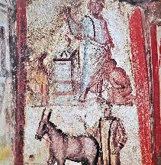
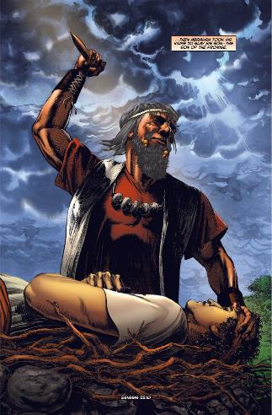
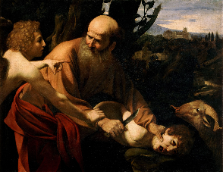
Visual Language and Stories:
Combining Text and Image
Rich artistic language from each of these traditions to inform the art
How much is it drawn upon?
Where and how does it show up if at all?
How are the texts constructed? How do they treat the source material for these stories?
Catacombs of Peter and Marcellinus
Caravaggio - Uffizi
Kinstone Comics

Slide 8
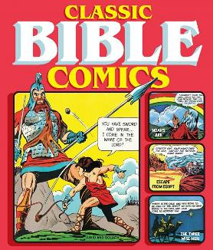
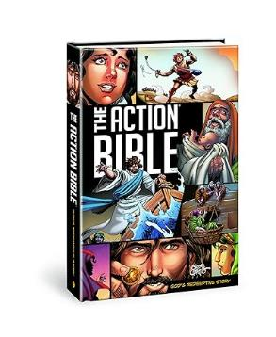
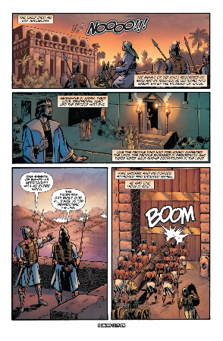
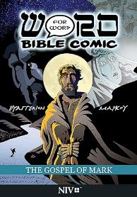
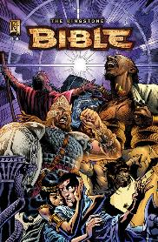
Christianity and the Bible
Many comic attempts to capture the Bible with mixed success - 3 considered closely here
The Comic Bible, Action Bible, Word for Word
Purposes and rough outline of each (noting of other major versions like Kingstone)
Kinstone Comics

Slide 9
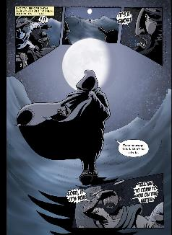
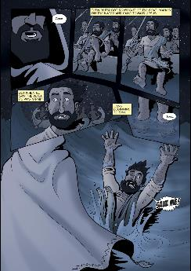
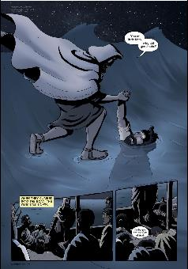
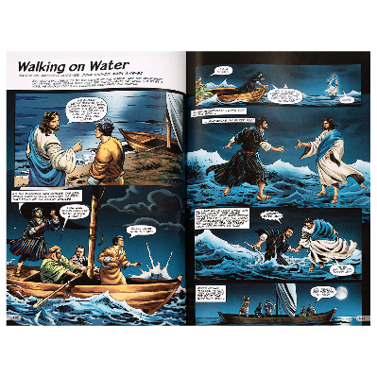
Possibilities with Comparing and Contrasting
With multiple treatments we can see the choices that are being made
Comparison with the Canonical Gospels and Biblical criticisms including especially Source, Form, and Redaction Criticisms (Gospel Parallels)
A number of comics with sacred stories and with religious biography with multiple treatments of the same source material (Bible, Buddha, Gandhi, Mother Teresa)
Word for Word - Gospel of Matthew
Action Bible

Slide 10
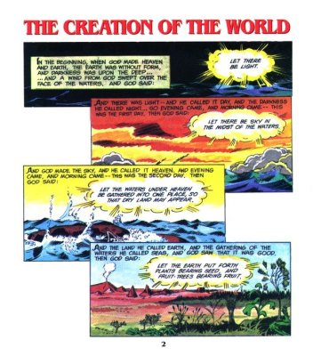
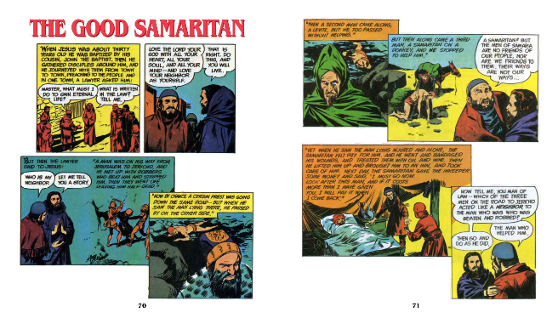
Classic Bible Comics
Combining Text and Image
Simple and literal approach
Limited choices in visual creativity
Emphasis on action
Imitation of comics of the period

Slide 11
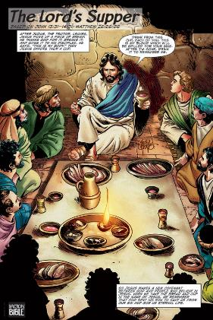
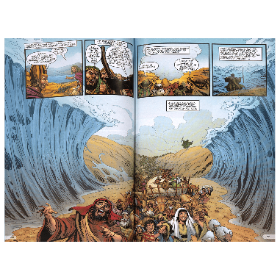
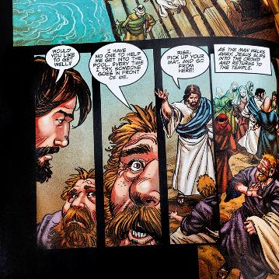
Action Bible
Reworking of the whole - both text and image
Lives up to its name… attention to action!
Focus on central Christian messages
Faithfulness to the core story while reorienting
Use of perspective and dramatic effect
Individuals and the crowd
Effectiveness…

Slide 12
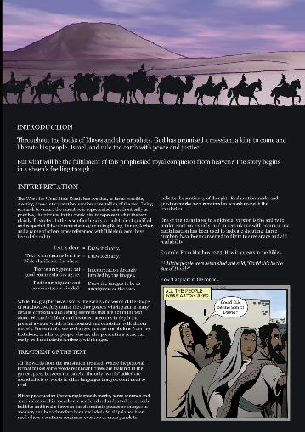
Word for Word Comics - Bible
Individual books
Massive undertaking and gradual publication
Clear approach stated at the beginning
Intentional use of the gutters, visual depiction, text (both narration and dialogue), use of other writings to fill in visual interpretation
Use of historic material throughout
Places of artistic license…

Slide 13
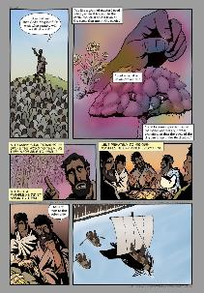
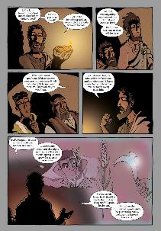
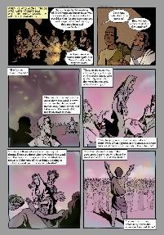
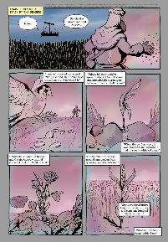
Envisioning the parables
Vivid stories - what is gained (or lost) with text and image?
Contained stories (pericopes)
Historic setting
Narration/action
Change in color tones
Experience as reader - Reader/Response Criticism

Slide 14
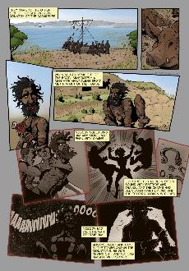
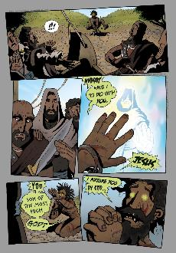
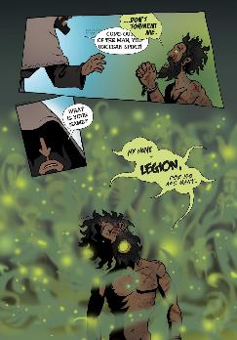
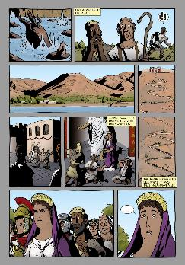
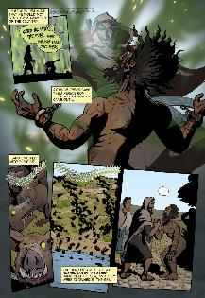
Demon Possession
Action sequence - vividness, power
How to show possession
Perspective
Jesus’ power
Consequences

Slide 15
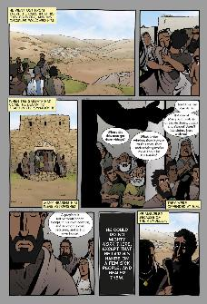
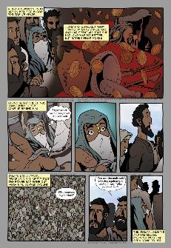
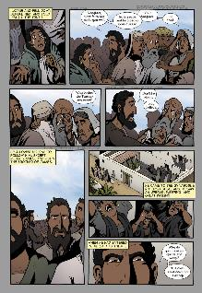
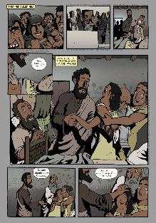
Interlaced Stories and audience
Theme around faith
2 women at different stages of life
2 healings
Central characters and those around them
Biblical stories with entangled pericopes - possibilities with visual and codex medium

Slide 16
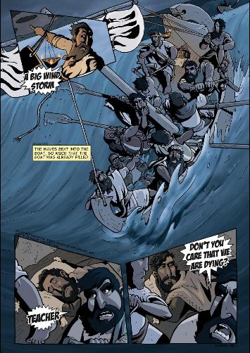
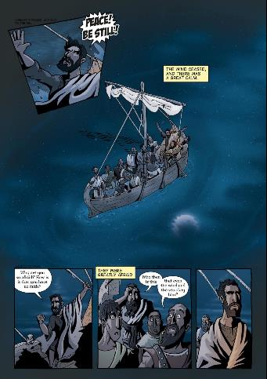
Envisioning miracles
Opportunity for Dramatic Action
Effectiveness of visual imagery alongside the text
Control of Perspective

Slide 17
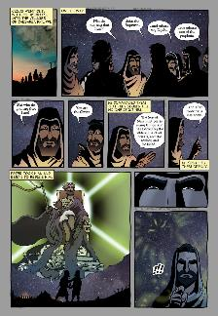
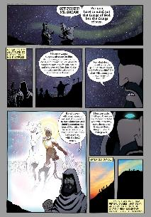
Theophany
How to envision divinity
How to see - and mis-see
Comics as a medium to show but also to challenge us in how we see and read

Slide 18
Hindu Sacred Texts
Range of texts and stories of the gods
Success of ACK and place in Comics/Indian Culture
Educating and carrying cultural identity
Treatment of Religious Practice and Sacred Stories

Slide 19
Bhagavad Gita
Deeper dive into a single work
Place in Hinduism
Importance in teaching Hinduism
Essential themes
Krishna

Slide 20
Bhagavad Gita
What is gained in Comic form?
Challenge of creating a comic out of a dialogue
Setting of war/dialogue hard to envision
How can you have such a sustained dialogue?
How is the setting so significant for the message?
Arjuna’s internal conflict - is it clearer?
Krishna’s self-revelation
Ability to act
The whole in this pregnant moment filled with possibility and choices - is it clearer?

Slide 21
Bhagavad Gita
Krishna’s self-revelation
Complex theological ideas given visual form

Slide 22
Hindu Sacred Texts - a few more stories
Unfamiliarity for most westerners, importance for Indians
Idealized traits - exemplars
Cautionary Tales
Heroic exploits
Traditional life and Religion
Ramayana - the Golden Deer
Sati and Shiva
Hanuman
Ganesha

Slide 23
Stories of the Buddha
Focus from early on his teachings
Stories of his life focus on giving context to his teachings and arise later - essential moments but not as fixed
Vedic/Hindu context
Prophecy
Major elements of his life: mother, birth, 4 sights, great renunciation, 5 ascetics, enlightenment, teaching, death - invite reflection on teachings and visual depiction

Slide 24
Buddha Manga by Tezuka Osamu
Tezuka Osamu’s importance - Eisner Winner
Massive complete work
Respectful but not pious
Stories alongside those of the Buddha throughout his life (many as made up characters who help add further context)
Major themes that fit with Buddhism
Ultimately a good and engaging manga
Religious elements woven throughout and how successful…

Slide 25
Setting for the Whole - Suffering as part of the world
Entire story highlights the reality of suffering
Suffering as part of the natural world
Characters that capture depths of suffering in the caste system
Sets up the 4 Noble Truths and 8-Fold Path

Slide 26
Tata’s “Death”
Manga style and feel
Character of Tata - long-suffering, connection to animals, enlightened (?), irreverent, in your face, spontaneous
Contrast to other characters including Brahman seeker
Tata’s death - self-sacrifice
(Suddenness of lives coming and going even of major characters - all alongside story of Buddha)

Slide 27
Buddha’s Birth
Expectation
Emotion and loss - theme of suffering and brevity of life
Death of his mother and Buddhist tradition
Signs of divinity
Traditional funerary/religious practices

Slide 28
The Five Ascetics
Setting of his contemplation
Challenging of the castes
Conflicts with a power battle
Manga sensibilities
As with much of the story, a deeper seriousness underlying

Slide 29
The Great Renunciation
Emphasis on all he is tapping away from…
His father’s perspective and fulfillment of the prophecy
His wife’s perspective
Flight from the palace
What is most important - great comic or authoritative treatment?

Slide 30
Enlightenment, Teaching, and Legacy
Richness of the whole…

