Slide 1
Religious Biography in Comics
Gandhi, Mother Teresa, Pope John Paul II, Dalai Lama, Vivekananda, and MLK

Slide 2
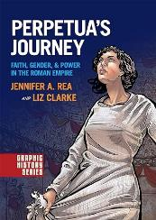
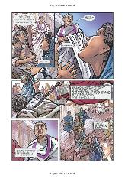
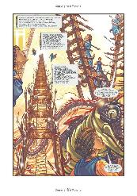
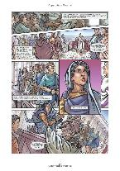
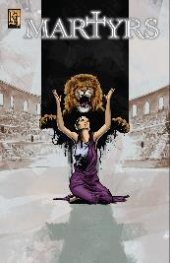
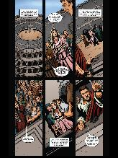
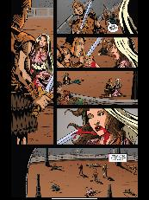
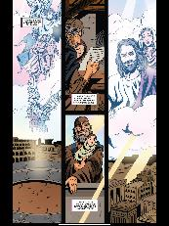
Long History of Religious Biography - Example of Martyrs
Martyrdoms within Christianity
Martyrdom Accounts of Perpetua (2 versions compared)
Different focus - academic and religious
Consider the range of purposes for biography of these figures and what is emphasized
Visual language and scenes that are chosen - essential to each creator’s purpose in telling a biography

Slide 3
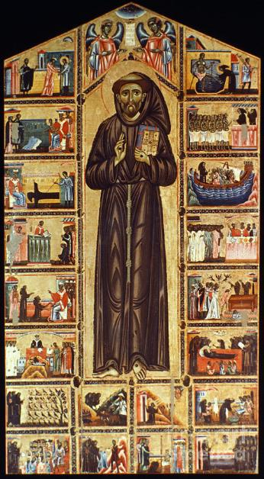
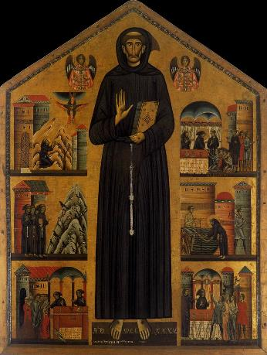
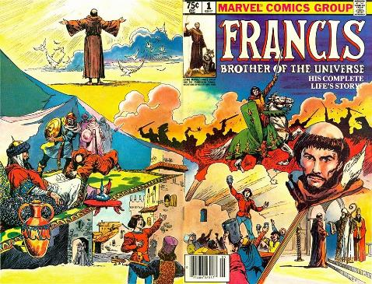
Hagiography and Sequential Art - Saint Francis
Marvel Comic of Saint Francis
Medieval depictions of his life in devotional scenic form
Rich possibilities for comparing traditional art with modern depictions in comic form

Slide 4
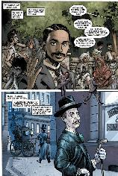
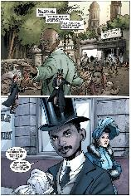
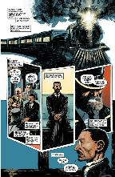
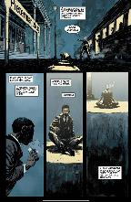
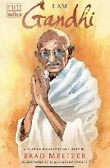
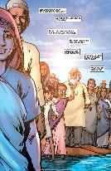
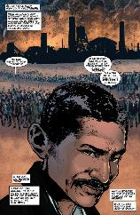
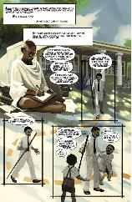
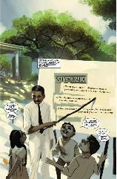
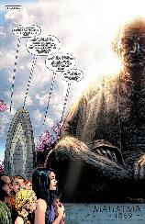
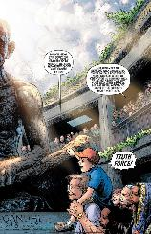
Gandhi - Comparison of 2 Comics
Modern and very recent version versus ACK
Modern treatment with single author and many artists - attention to his legacy and to him as exemplar for modern individuals and young people
ACK celebrating foundational figure in Indian independence, challenging of caste system, valuing of traditional Hindu identity
Consider especially treatment of political contributions
Treatment of religious elements of Gandhi’s life and especially his approach to non-violence
Treatment of his Indian identity and its expression
What does each treatment accomplish with its visual imagery and the stories it tells? How do they fit its goals?

Slide 5
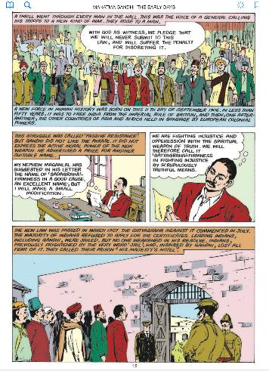
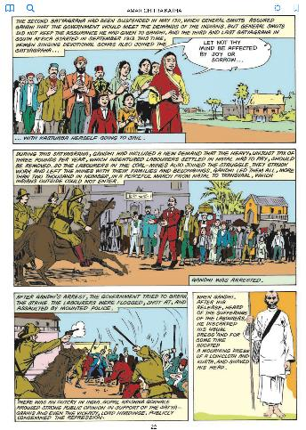
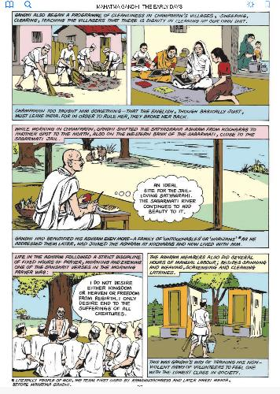
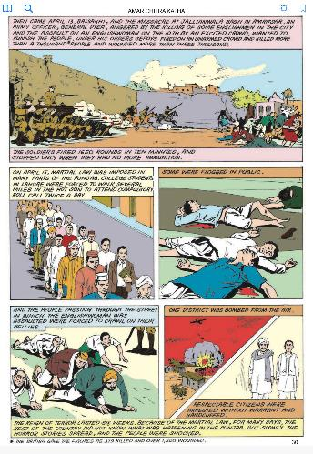
ACK Gandhi Comic (Comparison)

Slide 6
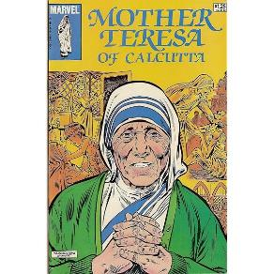
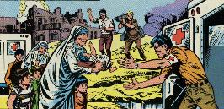
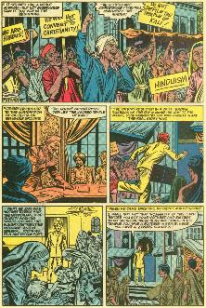
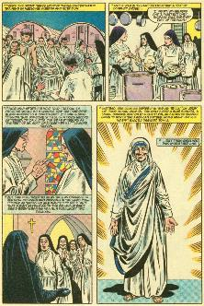
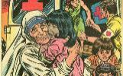
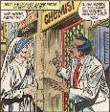
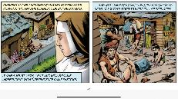
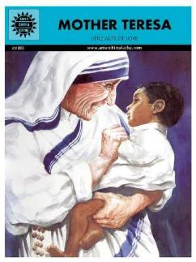
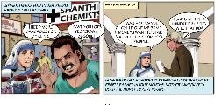
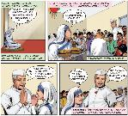
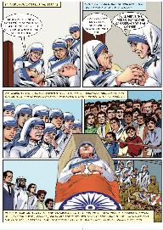
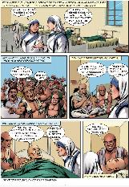
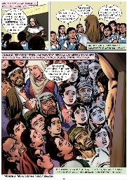
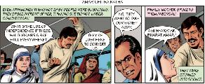
Mother Teresa - Comparison of 2 Comics
Marvel and ACK each have a comic dedicated to her
Perspective on her place in Indian life/religion
Her contributions and how to view them
Her faith and impact on society

Slide 7
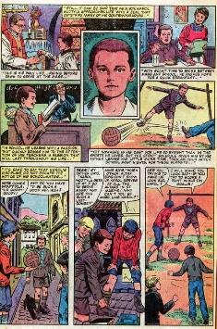
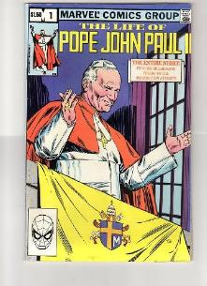
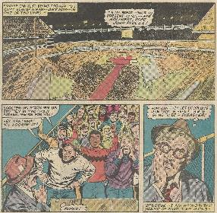
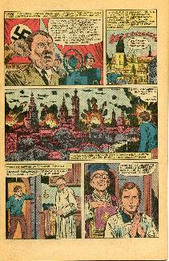
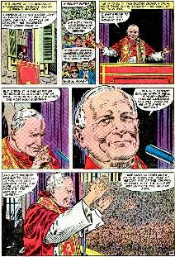
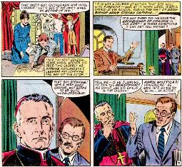
Pope John Paul II
Huge influence on the world
Narrative voice and perspective
Focus on his early life and telling a new story
Marvel Comic - why tell this story? Audience?
Value of Comic form in creating a rich sense of historic context
Dramatic moments of his early life and sense of action - threat of Nazi Germany and living under Nazi rule in Poland
His emergence and how these early experiences shaped him
Emphasis on community, everyday life and interests

Slide 8
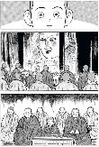
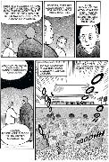
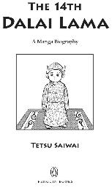
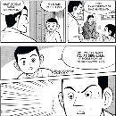
Dalai Lama
Vivid depiction of historic context and Chinese aggression
Celebration of Tibetan culture and way of life
Dalai Lama as leader and religious figure
Preserving his story and legacy
Manga style - effective means of communicating his story? How does it work? What does it capture best?
Officially endorsed - How is this different than other treatments we have encountered?

Slide 9
Vivekananda
One of many biographies of important Indian figures from ACK
Pivotal figure of Hinduism in America (World Parliament of Religions)
Ramakrishna’s importance
Historic Context
His religious ideas
Reception of his ideas
Fascinating figure for navigating Hindu identity in America (value for modern Hindus in America and elsewhere)

Slide 10
Martin Luther King Jr.
Foundational figure for American Civil Rights Movement
Relationship to earlier figures including especially Gandhi and Jesus - cf. with Gandhi on the train
Idea of nonviolent resistance (religious elements…)
His place in the community
His personal religious identity
Context and Crisis
The Montgomery Method and Christianity
What is MLK’s legacy? How should we read and understand him?
What does this comic version add to your understanding of this familiar figure?

