Slide 1
Eisner’s Contract with God

Slide 2
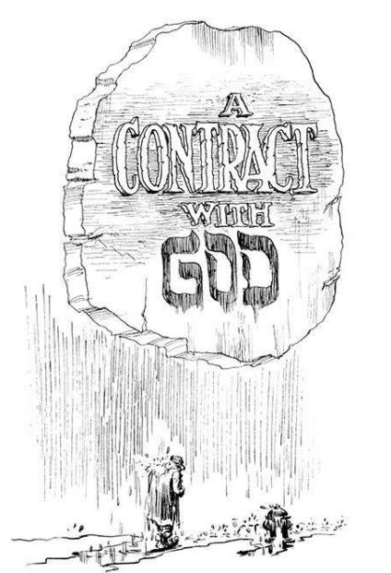
Context
Judaism and Comics
Narrowing our focus to a single powerful work
Deep dive into Judaism
What is possible with Comics as a narrative form
Notes:
Set up expectations for how we are going to work with his Comic/Graphic Novel
Introduce the place of Judaism within Comics more generally - The Amazing Adventures of Kavalier and Clay by Michael Chabon (2000) and winner of the Pulitzer Prize in 2001 is a good starting point also note Maus and other works including possibly a range of superhero characters
Emphasize the Jewishness of this particular novel and to watch for how it shapes the work as a whole and its interpretation
The value of focusing on a single rich work for analysis. This unit could be highly valuable early in a class (after orienting with McCloud’s Understanding Comics for a language and after working with simpler works dealing with Comics and Religion). If this unit is saved for mid-semester or later it can be used to highlight what is possible with the medium and the richness of religion within it.
The use of this Comic/Graphic Novel/Short Story to have a deep dive into very particular topics within Judaism - including grief and mourning practices, covenant relationships and what it means to live as a “holy people”, corporate and individual identity within Judaism, the immigrant experience
Focus throughout on how successful Eisner was (or was not) in accomplishing his goal of creating a truly literary work and challenging himself and what was possible with comics/graphic novels.

Slide 3
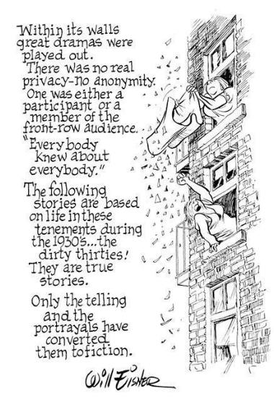
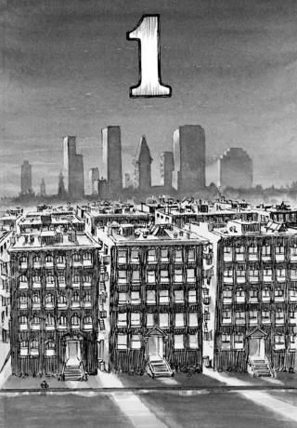
Eisner and the Graphic Novel
Experimentation with the comic form
Use of comics to educate grade school children
Instructional manuals for American soldiers
Newspaper comics - weekly format with The Spirit
Creation of a “Graphic Novel” and struggles with the publishing industry (inspiration from experimental graphic artists of the 1930s)
Ours is one of four short stories set in a street (Dropsie Avenue) and tenement
The building itself as a character and a part of the story and “contract”
Notes:
The focus here is on Eisner. Note how incredibly important he is in the development of Comics. His lasting legacy and the Eisner award. Possibly note critiques of his representation.
Give a sense of his contributions over time and experimentations with the form. This work is the culmination of so much that went before and also a true challenge and experimentation with what is possible.
Eisner’s place in the creation of/popularizing of the Graphic Novel as a form.
The short story format and the place of Dropsie Avenue and this tenement building in particular. A place to set his memories and stories but also a setting with a life of its own. The visual use of a structure to create a landscape and architecture for his stories. The sense of individual stories taking place in a shared and chaotic community.

Slide 4
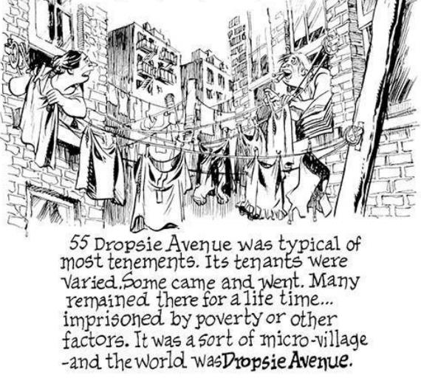
A Collection of Short Stories… (Literary Criticism)
4 Short Stories set on Dropsie Avenue
Intention of creating “literary comics” (foreward 2004)
Analyzing as a piece of literature
Relation to other works - especially Job and other Biblical texts; connection to Jewish traditions and practices
Notes:
The ability to use literary approaches to analyze comics generally and this graphic novel in particular. The danger so often with academics of over-reading into material. Comics in particular are prone to such challenges, especially when they may be simpler in conception or articulation. Here we have a work that is truly intended as literary and intends to be ground-breaking. It holds up exceptionally well to literary analysis. There are any number of ways to use this story for analysis - either to model it yourself in teaching (which I try to do later with 2 smaller explorations with light and with mourning and the mourner’s Kaddish), or to use as an assignment for students. Students often have a moderately sophisticated ability to work with literature. This story can prove an excellent opportunity to engage their ability to analyze them and to challenge them to fully engage the possibilities of the comic form. Consider for instance having students identify major themes and exploring them, consider the individual characters, the narrative flow, protagonist/antagonist, etc. In short have them use everything they might know from working with literature and see what it yields here.
This story also invites a range of comparisons with other works including especially Biblical works. It could for example be usefully analyzed alongside parts of Job, or possibly Elie Wiesel’s play The Trial of God (1979).

Slide 5
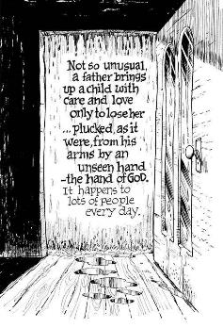
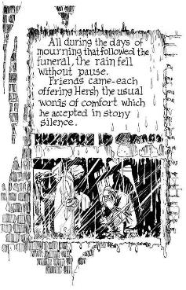
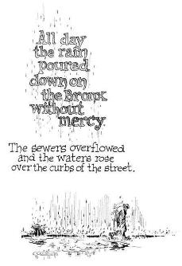
The Comic Form - Text and Image
Work with The Spirit (weekly Sunday comic) - experimentation with the form
Core concept - the medium - the arrangement of words and pictures in a sequence was an art form in itself and could deal with meaningful themes (foreward 1978).
A narrative dealing with intimate themes and built on memory. Preserving a time and place.
Picture and text intended to be “so totally dependent on each other as to be inseparable for even a moment” (foreward 1978).
Letters drip… frames fade away… control of perspective…
Text and image are all part of one whole - telling the story and evoking response

Slide 6
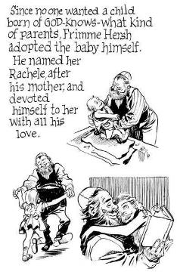
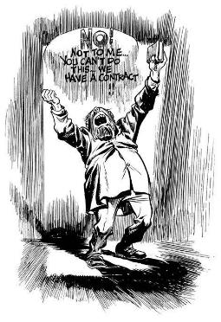
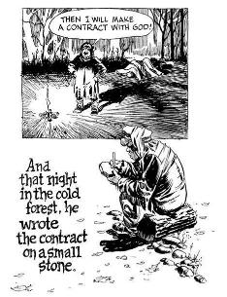
Major Themes
Subject of human relationship with God… punishing or rewarding based on a contract defined and reinforced by clergy and parents.
Loss and struggle with God - his own struggle with his loss of his 16 year old daughter Alice to Leukemia. “(Frimme’s) anguish was mine. His argument with God was also mine.” (Foreward 2004).
What is the relationship between humanity and God? Is it a contract? How are each bound?

Slide 7
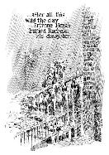
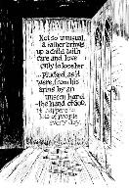
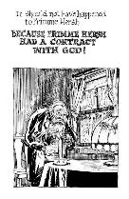
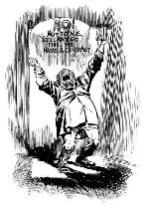
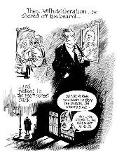
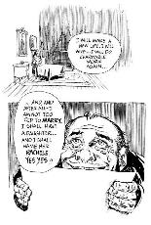
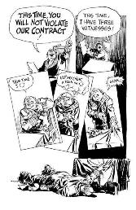
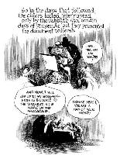
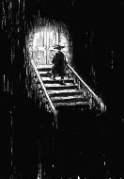
Framework of the Story…
A single continuous narrative - his daughter has died, angry dialogue with God, mourning, living in opposition to God, making a new contract, his death, a new boy finding his contract and making it his own
Flashbacks - to his childhood and original contract, to his early life in New York and to his daughter
Lots of narration and images to tell the story
Periodic dialogue in more traditional comic form

Slide 8
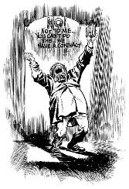
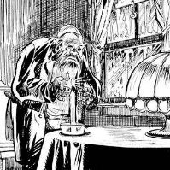
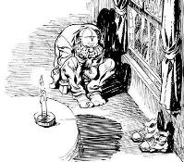
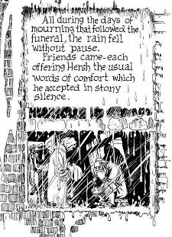
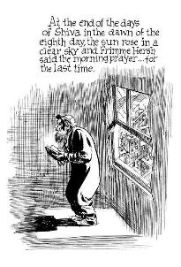
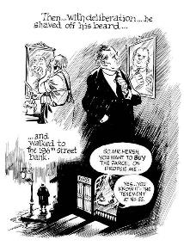
Grief and Mourning
Rain from the beginning and again at the end
Images of Himme
Observation of the mourning period and Shiva
His return to the world (compare to the Kaddish)
Lack of acceptance
Fulfilling the requirements then turning against God
(recurring light… the Yahrzeit candle)
Grief and response to grief at the heart of the story

Slide 9
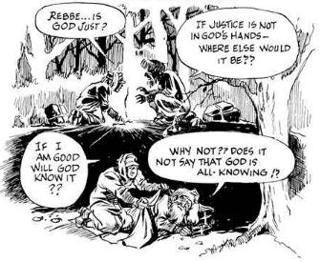
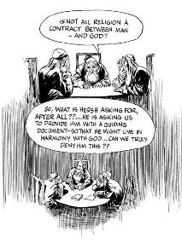
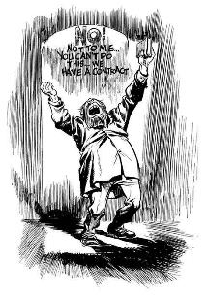
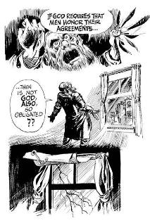
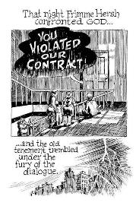
Theological Questions
Why do bad things happen to good people? (cf. Kushner)
Why do good things happen to bad people? (consider his post grief transformation)
What is the nature of a contract (covenant) with God? (his childhood version and later version from the rabbis; Biblical covenants and Jewish practice)

Slide 10
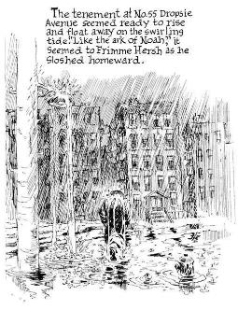
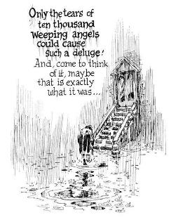
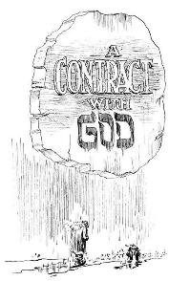
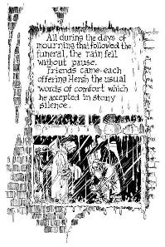
Religious Elements contributing to Narrative Force
Job story…
Noah story…
Ideas of Covenant
God’s chosen people
Mitzvot
Grief and remembrance
Mourner’s Kaddish

Slide 11
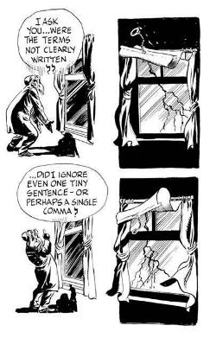
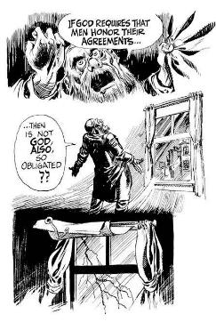
God as a Character in the Story
Is God present throughout? Where and how? Is God absent? What would each mean…
Question of representation of God in Judaism visually (and more generally in interactions with humans/creation)
Dialogue with God… When does the conversation/dialogue begin? End?
God’s presence in forces of nature - rain, lightning, fire, light, life and death…

Slide 12
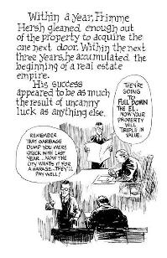
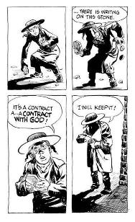
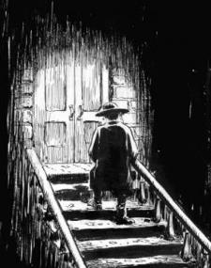
Uncomfortable Answers?
Does the story truly have a moral?
Does God answer and if so how? (cf. Job)
Are Himme’s actions justified?
Did God bless Himme? Curse him?
Can or should we expect God to protect us from grief and loss?
Does this story ever really end… Epilogue…

Slide 13
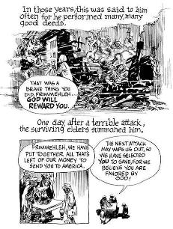
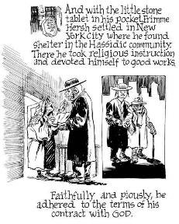
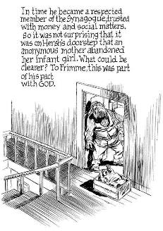
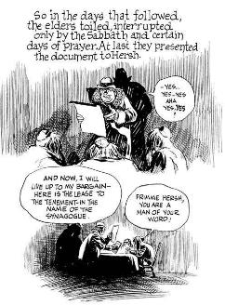
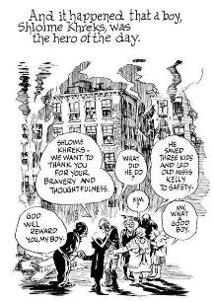
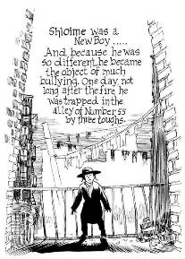
Jewish Immigrant Community
Woven throughout the fabric of the whole
His initial story
Sense of community and care
Child on his doorstep
Relationship with the Synagogue/Rabbis
His betrayals of the community
“New Boy” - persecution, responsibility, dedication

Slide 14
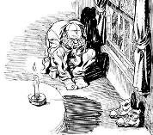
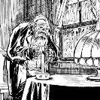
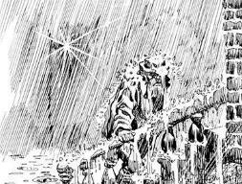
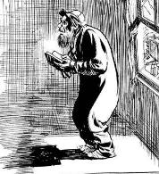
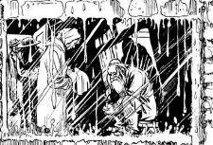
Visual and Literary Themes to Explore - One Example
Light -
Connected to God’s Power and Creation
As symbol of hope
Mourning and remembrance
When and how it appears - paralleling stories with the rabbis and contracts
At the start and end of the story alongside Himme and the new boy with their contracts
Is it part of the God’s dialogue with Himme?
What does the use of light in the story tell us about the larger themes and their resolution (if they have any)...
Use of Shadow throughout…

Slide 15
The Mourner’s Kaddish and A Contract with God
Used to read against the narrative and themes of the whole
Highlights elements in the story and deepens religious questions
Centrality in Jewish mourning
Lavish praise of God
Acceptance of God’s power, control, and will
Individual and corporate
Contrast with Himme’s rejection of his place in the community and responsibilities
Himme’s rejection of God in the face of grief
Himme’s views of himself and his life - rejection of God’s blessings and attempt to take control
Lack of acceptance of God’s power
Inability to escape his relationship with God

